Slide 1
Training: Monitoring and Early Warning for Floods.
GEOGloWS ECMWF Streamflow Monitoring and Forecasting.
Calvince Wara
RCMRD

Slide 2
GEOGLOWS PARTNERSHIP & COLLABORATION
The Group on Earth Observations Global Water Initiative GEOGloWS - pioneered a transdisciplinary collaboration of experts and organizations to establish the GEOGLoWS - ECMWF Streamflow forecasting service.
The service was initially funded by NASA and the World Bank with strong support from Brigham Young University, Esri, and NOAA.
The partnership has grown to more than 30 institutions and the service is hosted by the European Centre for Medium-Range Weather Forecasts, ECMWF.
The resulting operational services at ECMWF have been foundational in ministerial and national decision-making during flooding events worldwide
GEOGloWS provides access to actionable water data, information, and knowledge to bridge the digital divide and promote global equity.
Notes:
Water Management Challenges in the Region
Competing water demands & interests
Over-reliance on in-situ instrumentation – Data gaps
Poor water resources allocation plan –data gaps
Increased population, urbanization & catchment degradation
Inadequate capacity and technology for water resources monitoring and forecasting for planning and management

Slide 3
OBJECTIVE OF GEOGLOWS SERVICE
AIM: To provide inexpensive, timely, accurate and reliable user driven river flow data/information for;
Water resources monitoring, planning, allocation and management decisions (Ecosystem, domestic water supply, Irrigation hydropower).
Forecasting and monitoring of hydrological extremes (droufght & flood) to enhance preparedness for and disasters risk reduction.

Slide 4
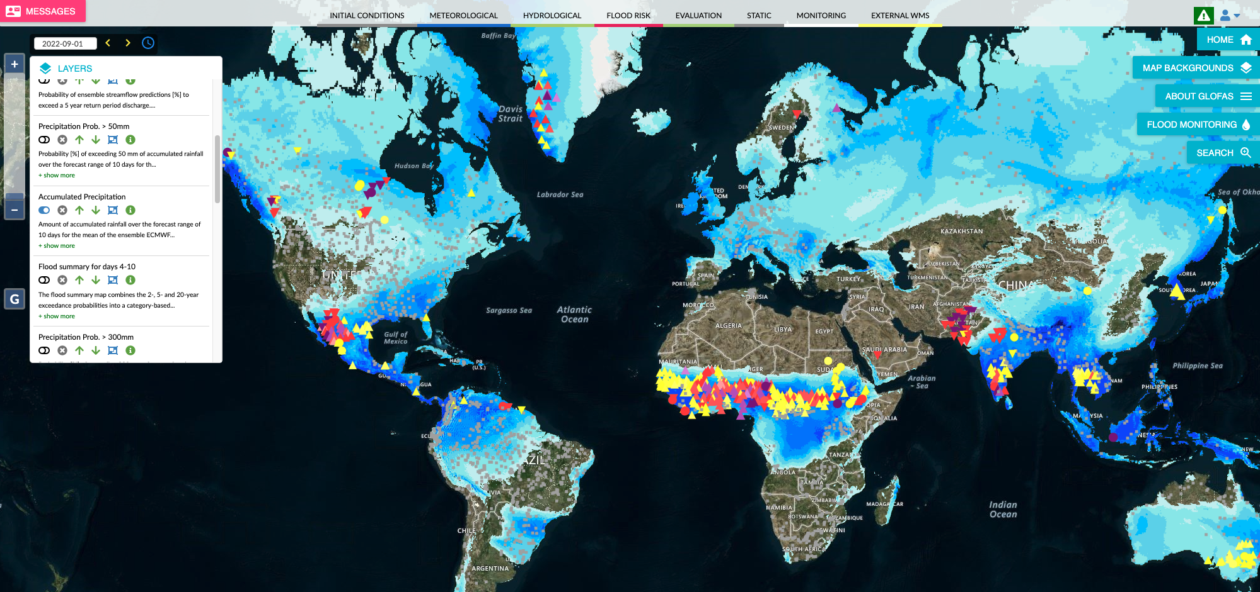
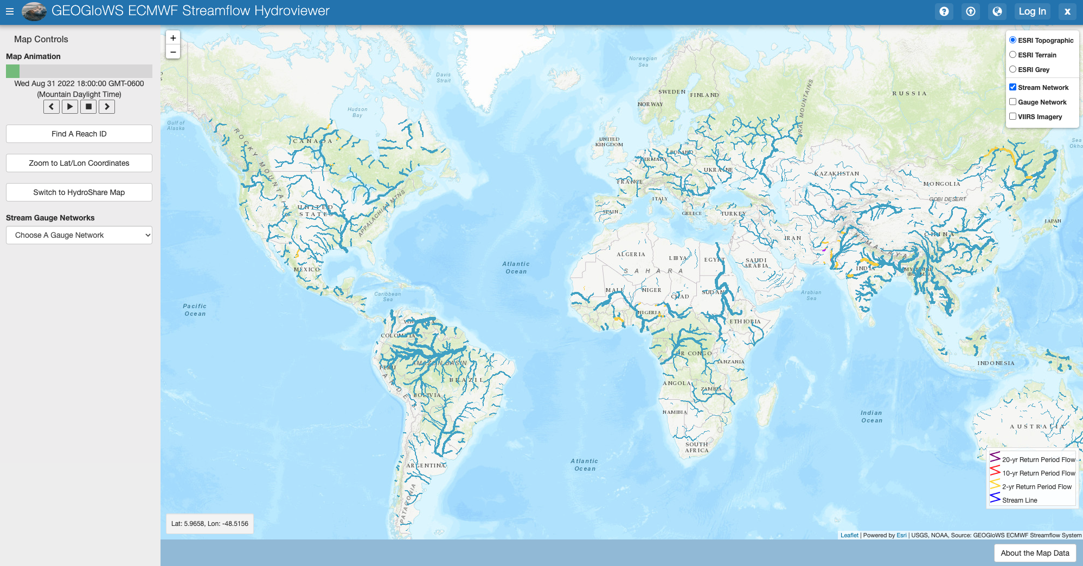
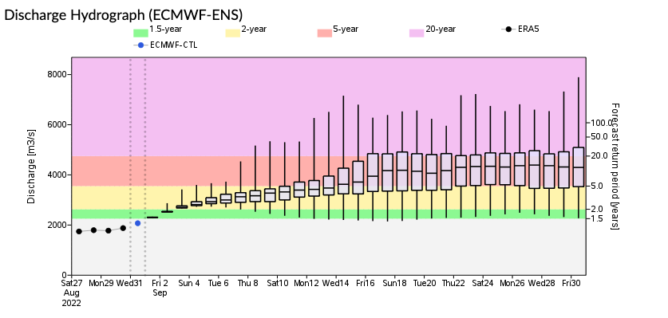
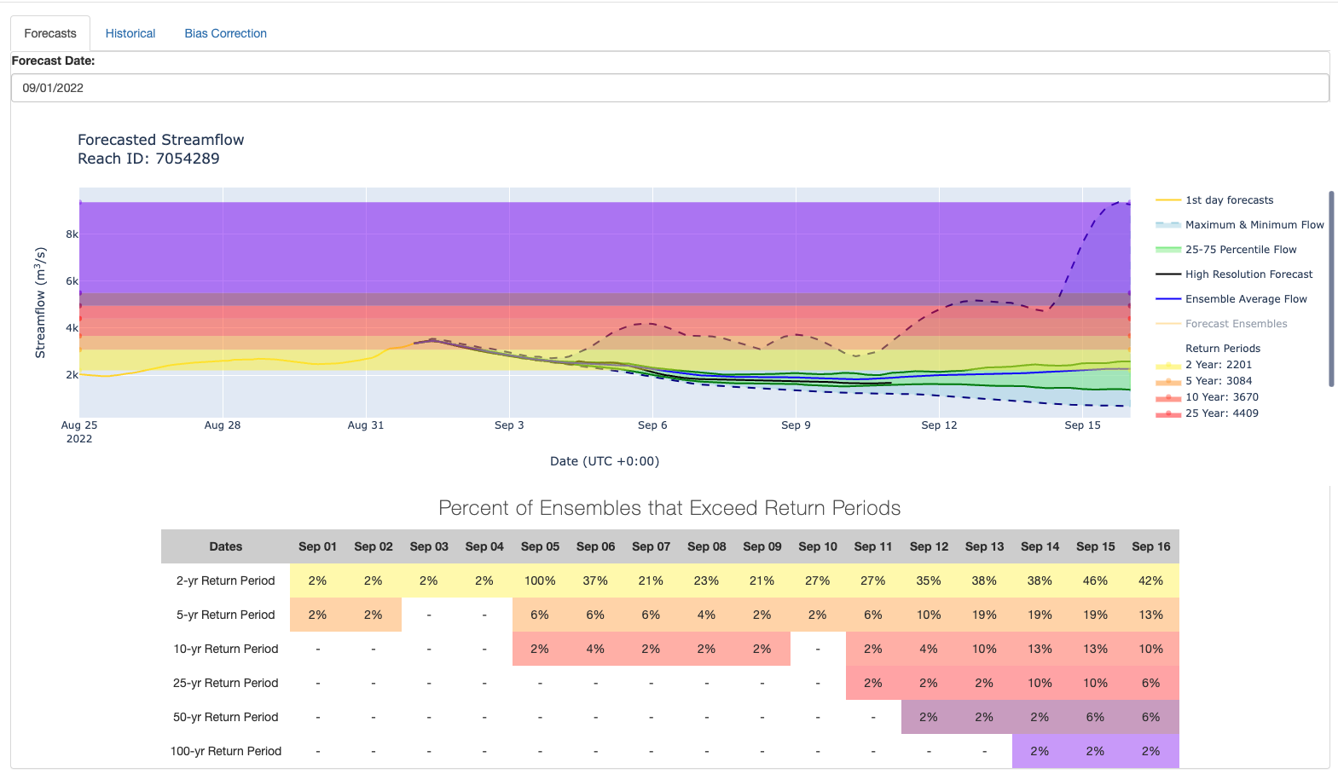
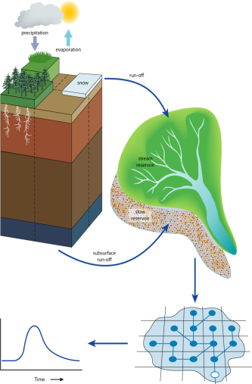
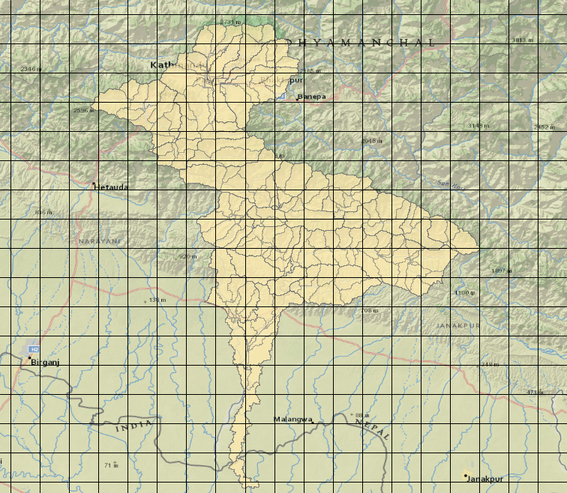
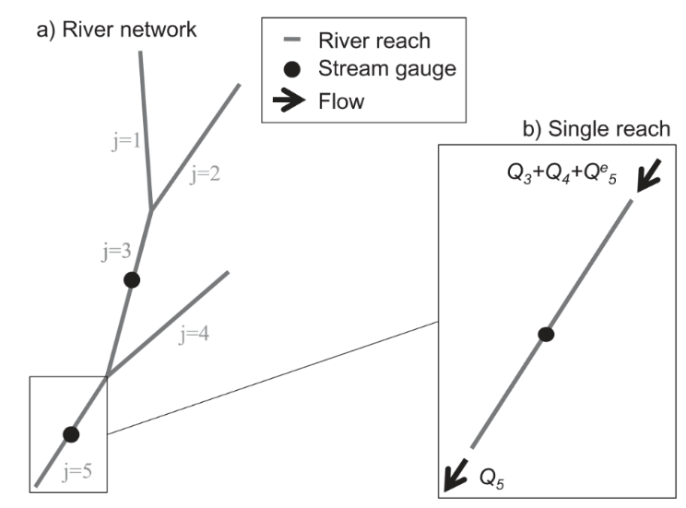
GloFAS and GEOGloWS – Model Concept & Framework
GloFAS Viewer
GEOGloWS Streamflow Viewer
Hydrological Model:
LISFLOOD
LISFLOOD (JRC)
Groundwater + Routing
Hydrological Model:
HTESSEL (Hydrology Tiled ECMWF Scheme for Surface Exchange over Land)
LISFLOOD (JRC)
Groundwater + Routing
Notes:
Water Management Challenges in the Region
Competing water demands & interests
Over-reliance on in-situ instrumentation – Data gaps
Poor water resources allocation plan –data gaps
Increased population, urbanization & catchment degradation
Inadequate capacity and technology for water resources monitoring and forecasting for planning and management

Slide 5
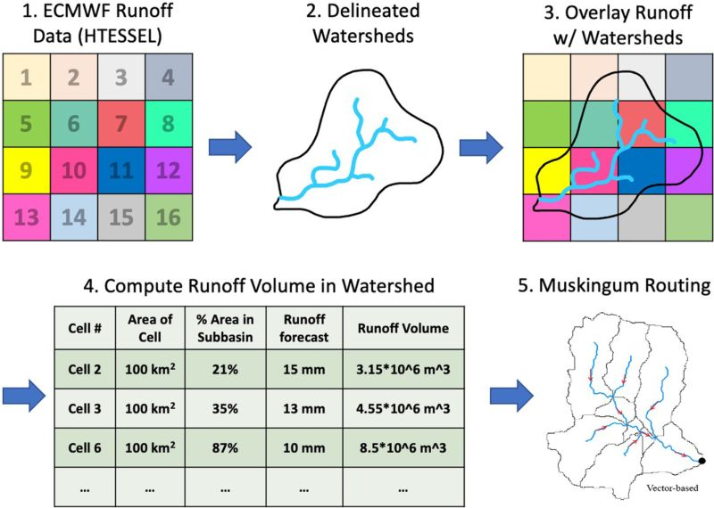
GEOGloWS –Streamflow Generation
Notes:
Water Management Challenges in the Region
Competing water demands & interests
Over-reliance on in-situ instrumentation – Data gaps
Poor water resources allocation plan –data gaps
Increased population, urbanization & catchment degradation
Inadequate capacity and technology for water resources monitoring and forecasting for planning and management

Slide 6
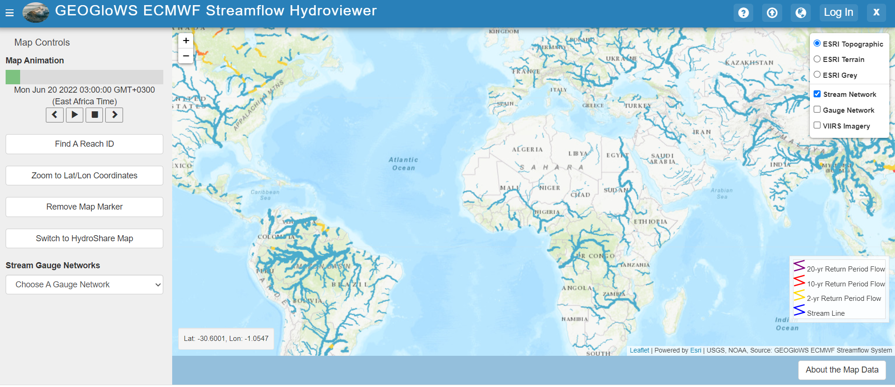
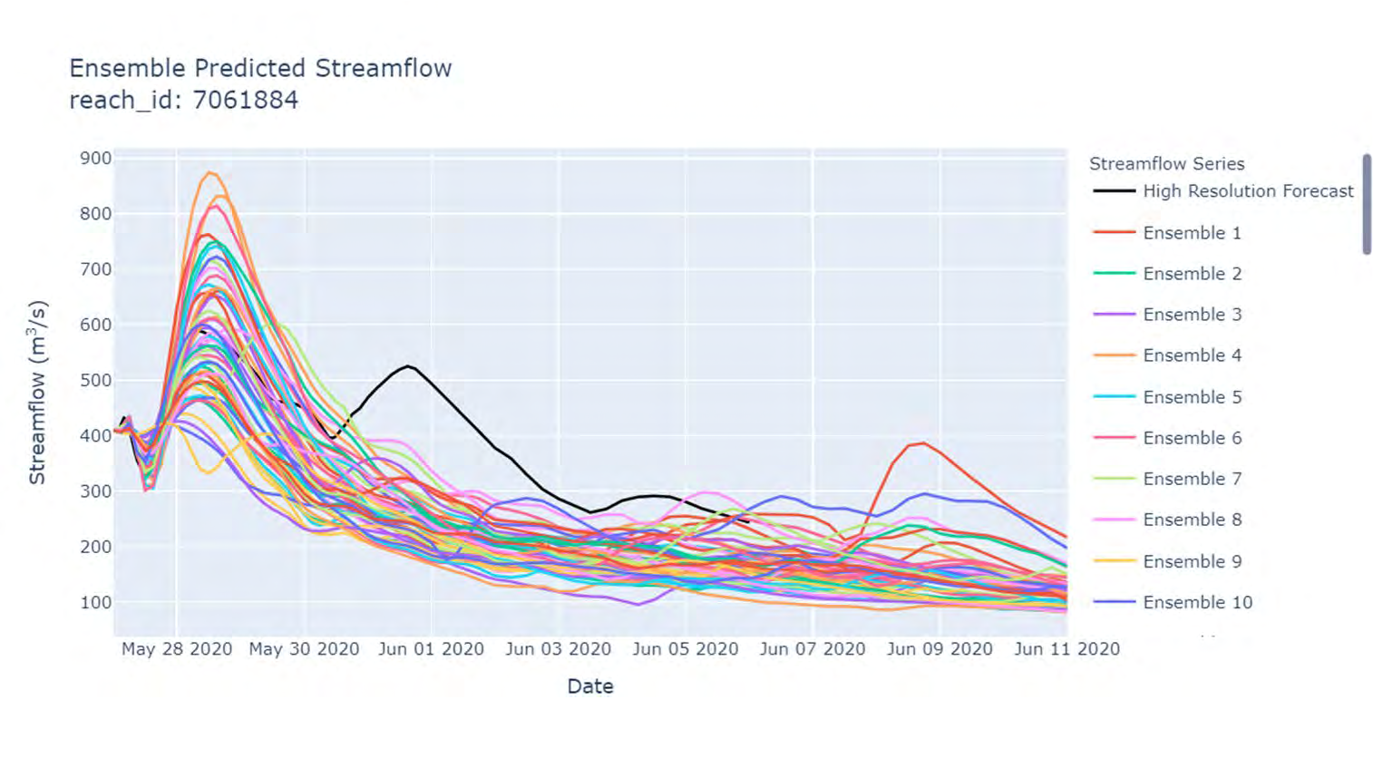
GEOGLOWS ECMWF STREAMFLOW
https://apps.geoglows.org/apps/geoglows-hydroviewer/
https://tethys.byu.edu/apps/geoglows-hydroviewer/
The system combines modern computing technologies & cyber-infrastructure with hydrological and hdraulic science to deliver a web-based service & cloud computing operational hydrological data necessary for water resources planning and management.
It provides timely streamflow short range forecast from ECMWF -51 member ensemble with 15 days, for 3 hrs resolution.
Generating single 1-hr high resolution 10-day forecast.
Near-real-time data is also generated to allow bias correction with observed data.
Notes:
Water Management Challenges in the Region
Competing water demands & interests
Over-reliance on in-situ instrumentation – Data gaps
Poor water resources allocation plan –data gaps
Increased population, urbanization & catchment degradation
Inadequate capacity and technology for water resources monitoring and forecasting for planning and management

Slide 7
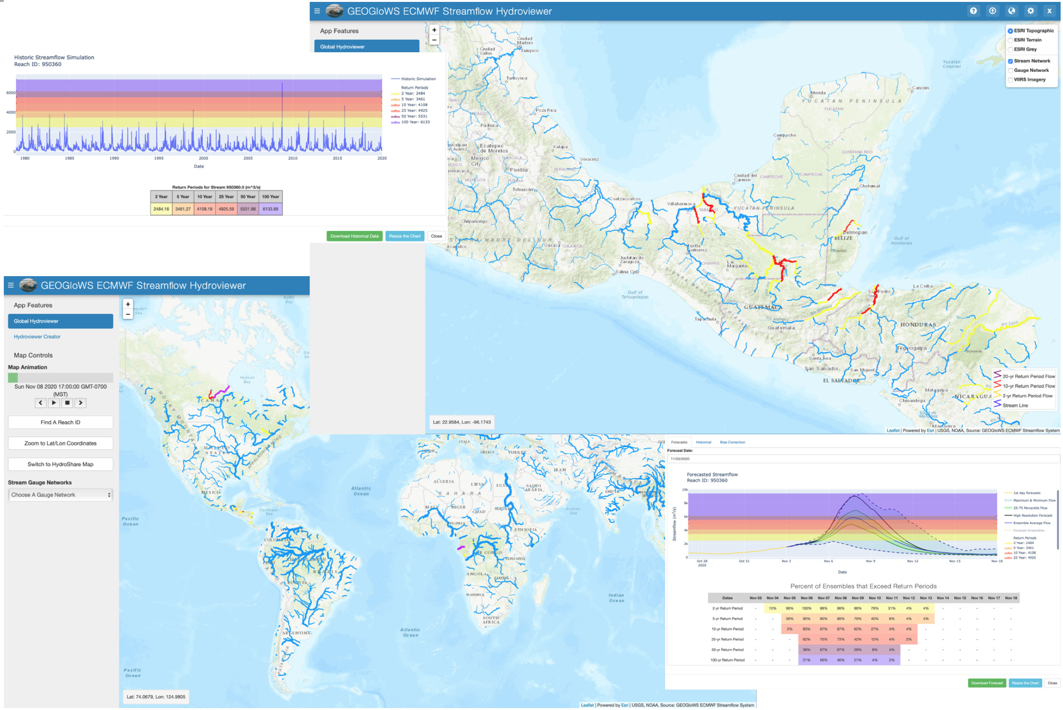
GEOGLOWS ECMWF STREAMFLOW DATA ACCESS
Both the river discharge forecast and historical simulation are made available as data services through
Web-App Viewer Platform
Representational State Transfer /Application Program Interface (REST API)
Extended through the python geoglows package available at PyPI and Conda also implementable through Google Colab.
Esri has developed a web mapping service hosted on the Esri Living Atlas, which can be animated and indicates where high flows and extreme events are possible in space and time.
The forecast service requires and leverages the local data and local expertise to tailor the global forecast to local applications.
The free and open services complement local efforts to provide information where little or none exists and have been designed to address communities' critical needs worldwide. It allows the local stakeholders to develop tailored applications to solve water management problems such as flooding, drought, and water/food/energy security issues.
Notes:
Water Management Challenges in the Region
Competing water demands & interests
Over-reliance on in-situ instrumentation – Data gaps
Poor water resources allocation plan –data gaps
Increased population, urbanization & catchment degradation
Inadequate capacity and technology for water resources monitoring and forecasting for planning and management

Slide 8
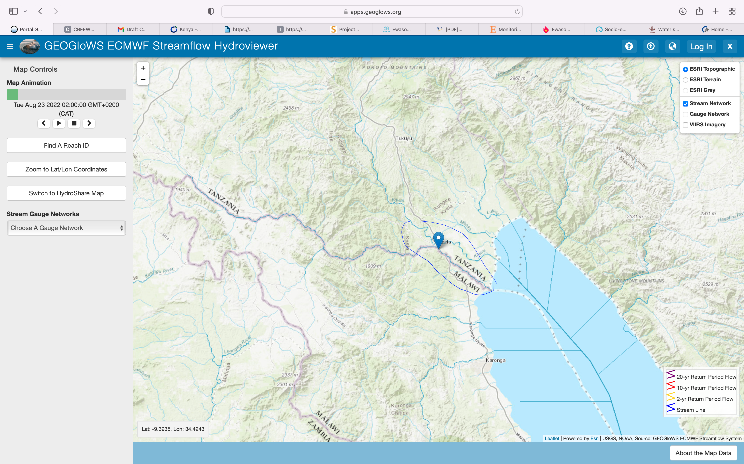
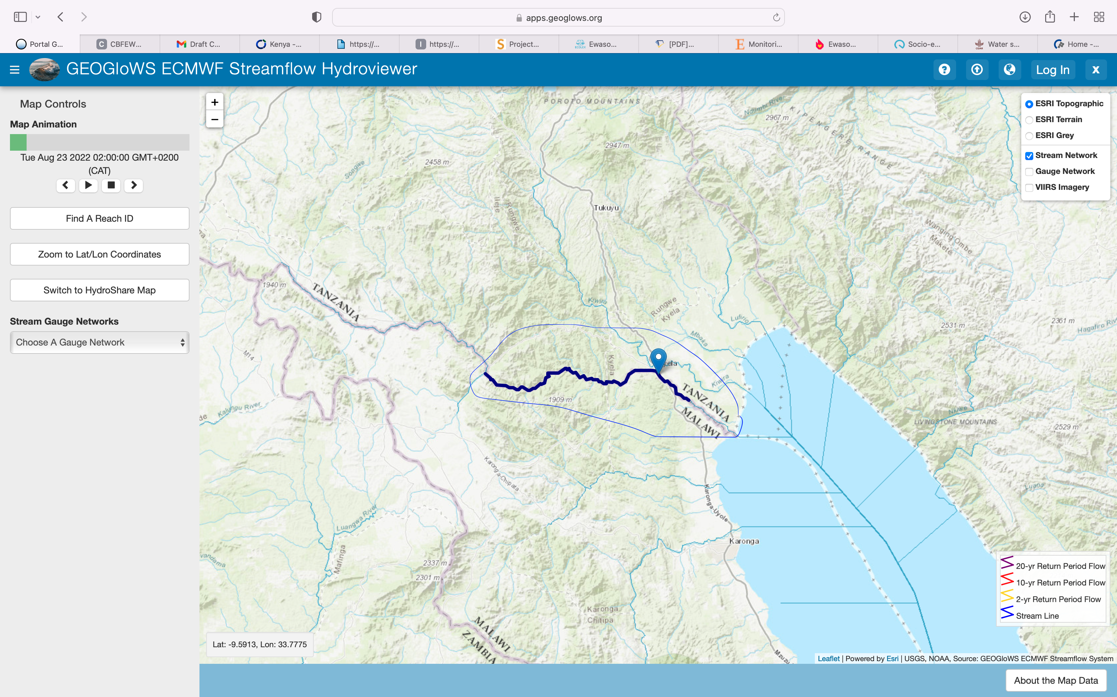
GEOGLOWS ECMWF STREAMFLOW DATA ACCESS
DATA ACCESS- WEB APP
https://apps.geoglows.org/apps/geoglows-hydroviewer/
The Location of interest along the river is identified by either Reach ID or Lat, Long coordinates.
Example – Songwe River in Malawi Tanzania (Reach ID 7084325, or Lat -9.5864, Long 33.7741).

Slide 9
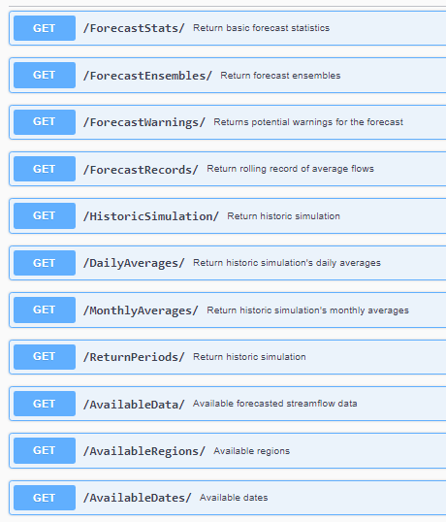
GEOGLOWS ECMWF STREAMFLOW DATA ACCESS
REST API
https://geoglows.ecmwf.int/documentation
Gets back a CSV of streamflow data
Global Model Dataset
Feb 1 22 … | 5 m^3/s
Feb 2 22 … | 6 m^3/s
etc… | etc…
Water Resources Engineer/Hydrologist/Hydrometeorologist
Notes:
Water Management Challenges in the Region
Competing water demands & interests
Over-reliance on in-situ instrumentation – Data gaps
Poor water resources allocation plan –data gaps
Increased population, urbanization & catchment degradation
Inadequate capacity and technology for water resources monitoring and forecasting for planning and management

Slide 10
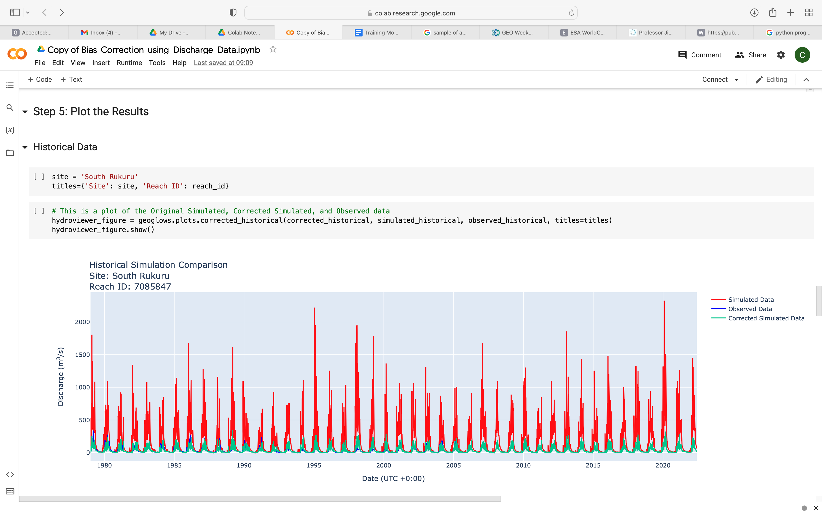
GEOGLOWS ECMWF STREAMFLOW DATA ACCESS
Python Package and Colaboratory Notebook API Access
The same functions to access forecasts have been created in a Python package called geoglows that is documented at this site: https://geoglows.readthedocs.io/en/latest/. Functions for manipulating and plotting the data are also included in addition to the functions that access the streamflow services through python code.
From Google Research. Colab allows anybody to write and execute arbitrary python code through the browser, and is especially well suited to machine learning, data analysis and education.
Colab is a hosted Jupyter notebook service that requires no setup to use, while providing access free of charge to computing resources including
Notes:
Water Management Challenges in the Region
Competing water demands & interests
Over-reliance on in-situ instrumentation – Data gaps
Poor water resources allocation plan –data gaps
Increased population, urbanization & catchment degradation
Inadequate capacity and technology for water resources monitoring and forecasting for planning and management

Slide 11
DEMO - DATA ACCESS- WEB APP
https://apps.geoglows.org/apps/geoglows-hydroviewer/
Example – Nyando River in Lake Victoria Basin (Reach ID 7072650, or Lat -0.12539, Long 35.001).
The forecast service requires and leverages the local data and local expertise to tailor the global forecast to local applications.

Slide 12
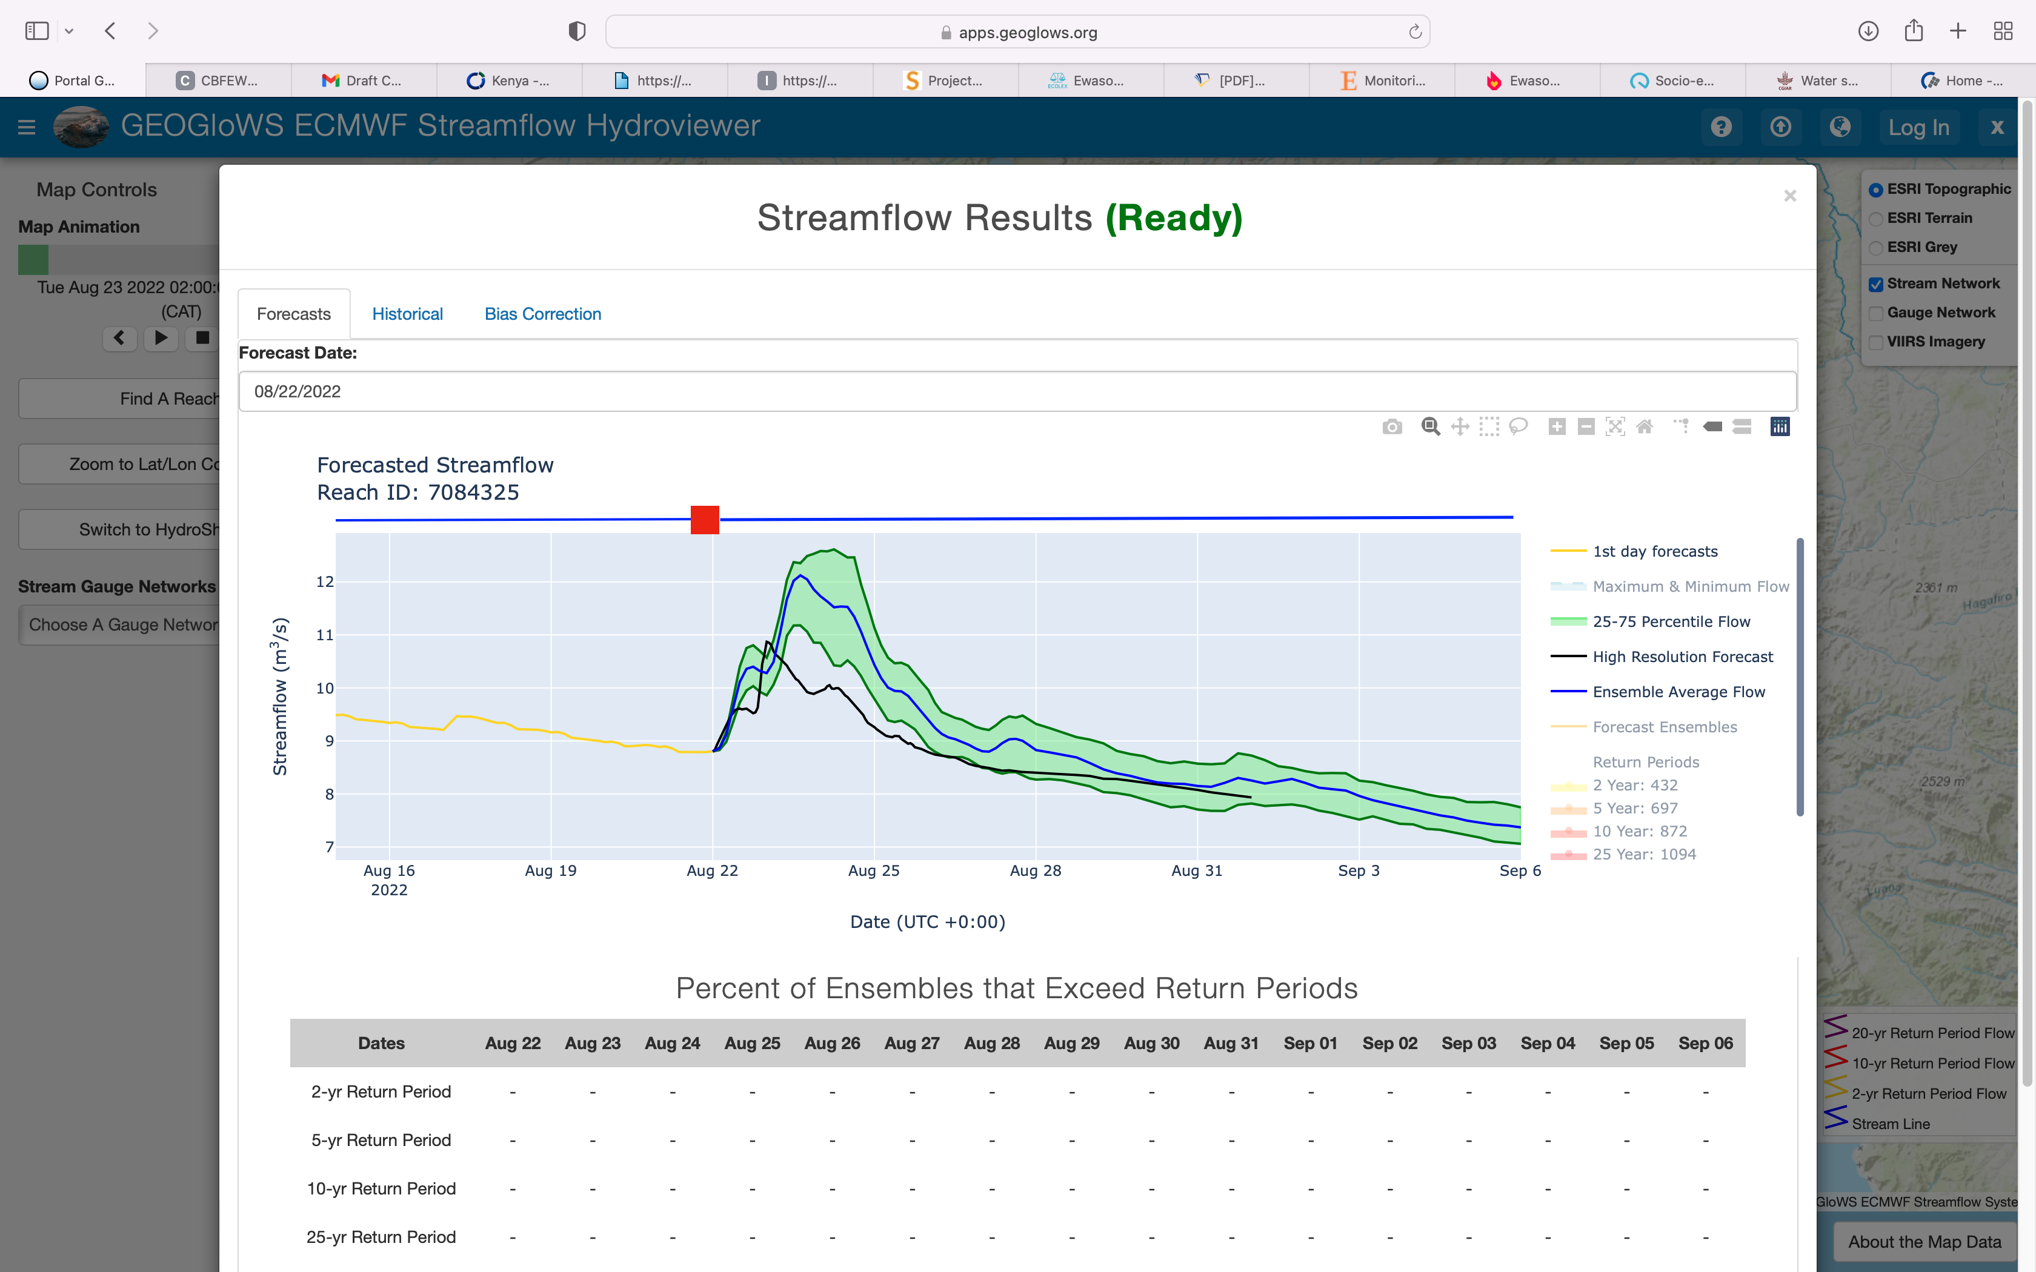
FORECAST STREAMFLOW DATA
Provides timely streamflow short range forecast from ECMWF -51 member ensemble with 15 days, for 3 hrs resolution.
Generating single 1-hr high resolution 10-day forecast.
Near-real-time data is also generated to allow bias correction with observed data.

Slide 13
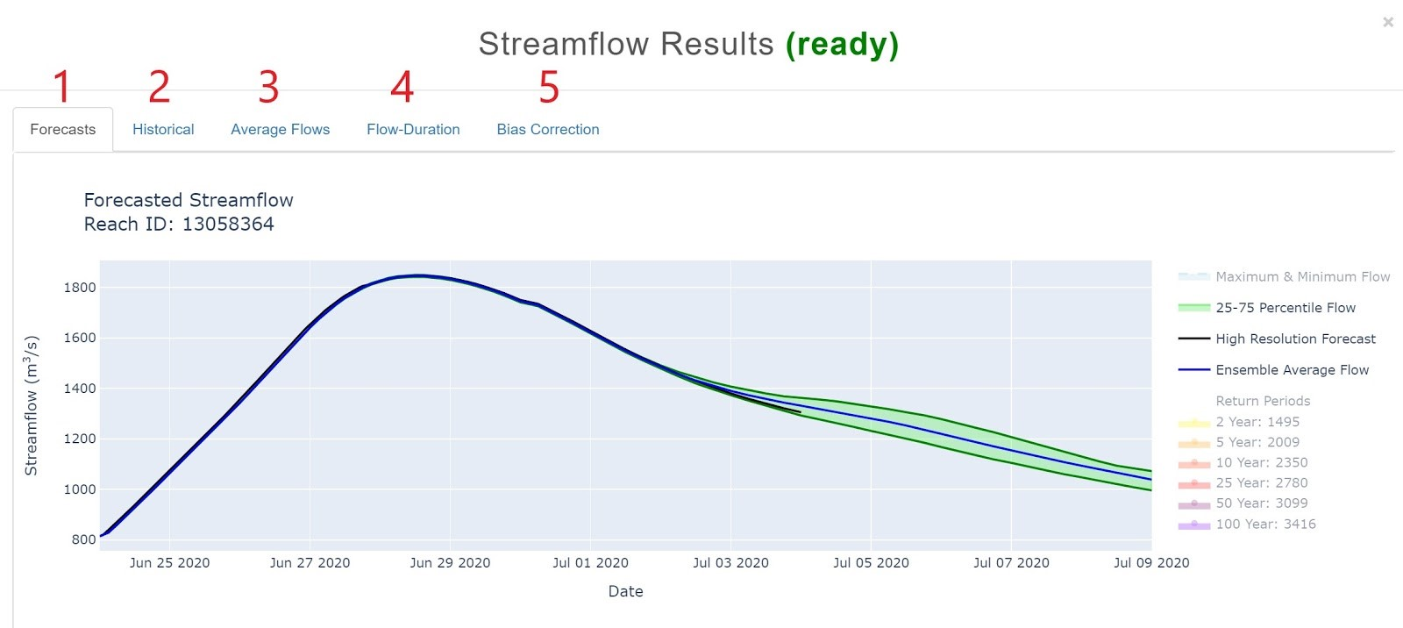
FORECAST STREAMFLOW DATA

Slide 14
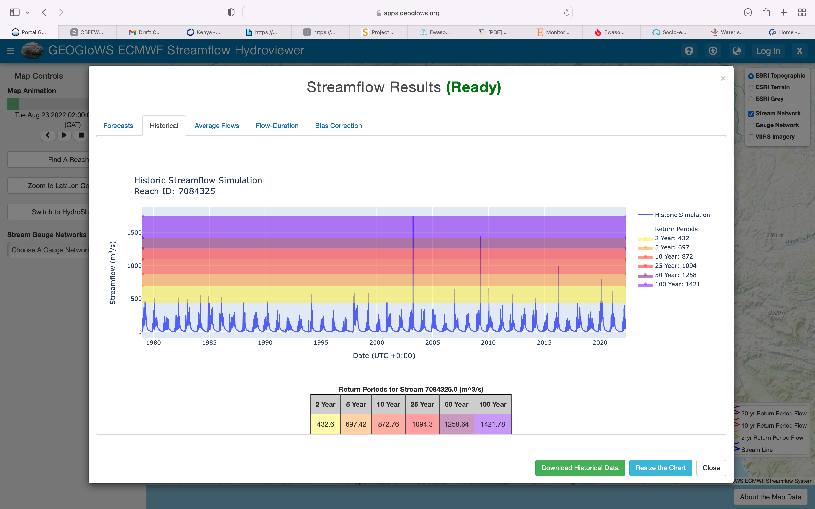
Historical Streamflow Data
The GEOGloWS service provides for every river in over 40 years of simulate historical data with computed statistical indices hence a breakthrough for data scarcity and gaps hence complementing the national efforts resulting in better planning, allocation and operation of dams, irrigation systems, and flood management.

Slide 15
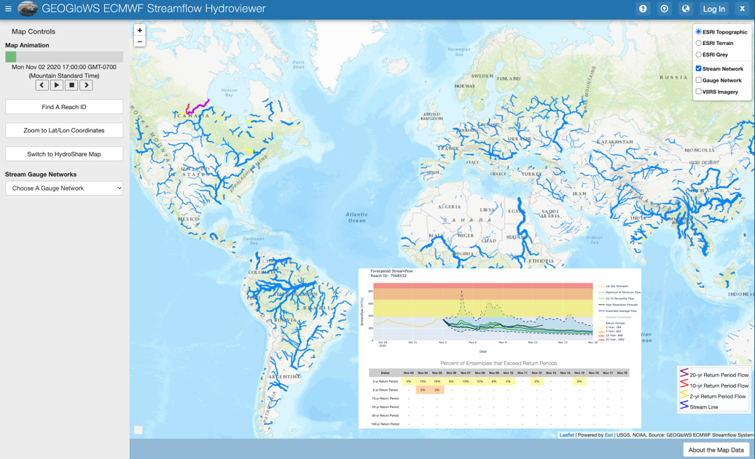
GEOGLOWS Data bias correction to local data
Allows for bias correction with local historically observed river flow data as a CSV.

Slide 16
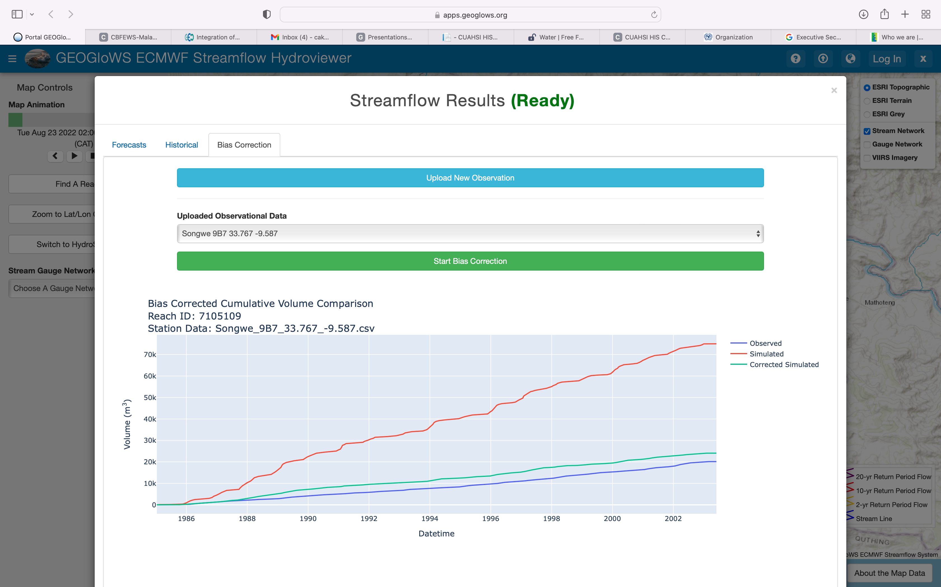
GEOGLOWS Data bias correction to local data
Allows the for bias correction with local observed data.

Slide 17
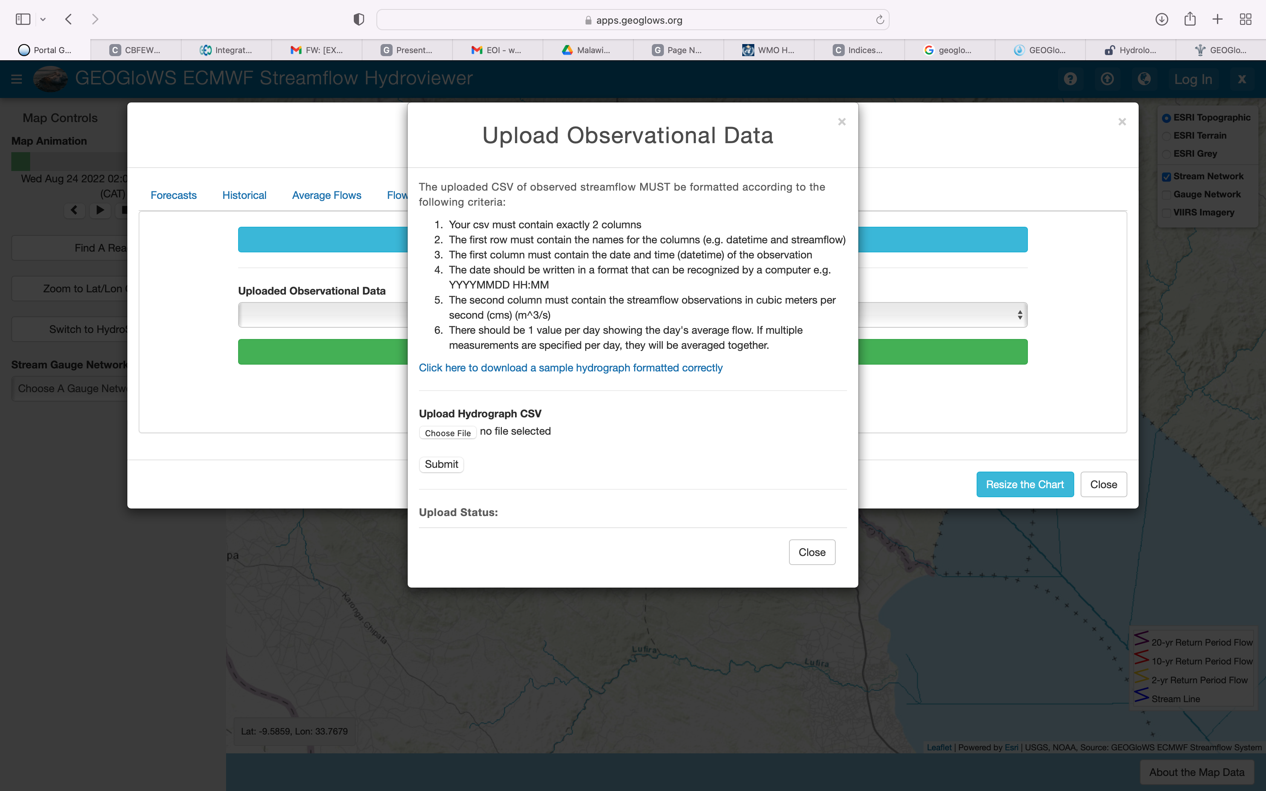
GEOGLOWS Data bias correction to local data
Allows the opportunity for bias correction with local observed data

Slide 18
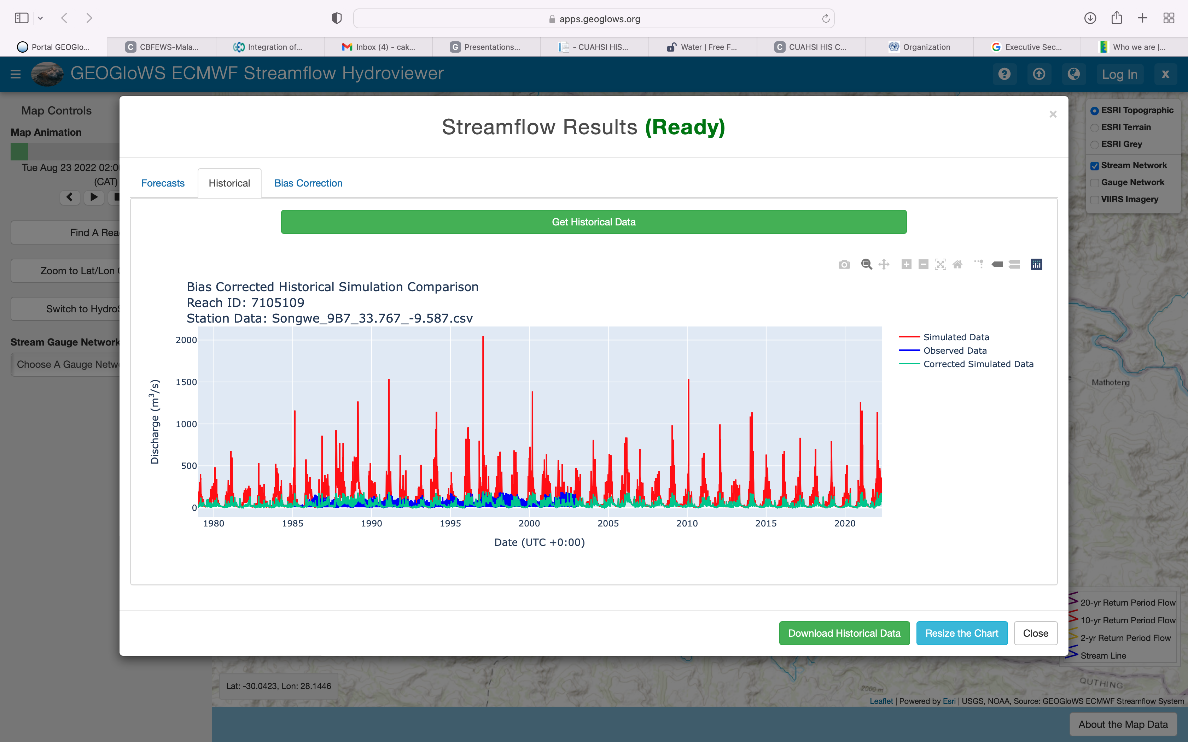
GEOGloWS Bias Correction on Historical Observed
With bias corrected GEOGloWS streamflow data, a 40-years, reliable streamflow data has been created and localized to the station and river reach levels filling the historical data gaps.
The data can now be used for water resources assessment and planning purposes.
Also created is bias correction factor for the forecast river flow.

Slide 19
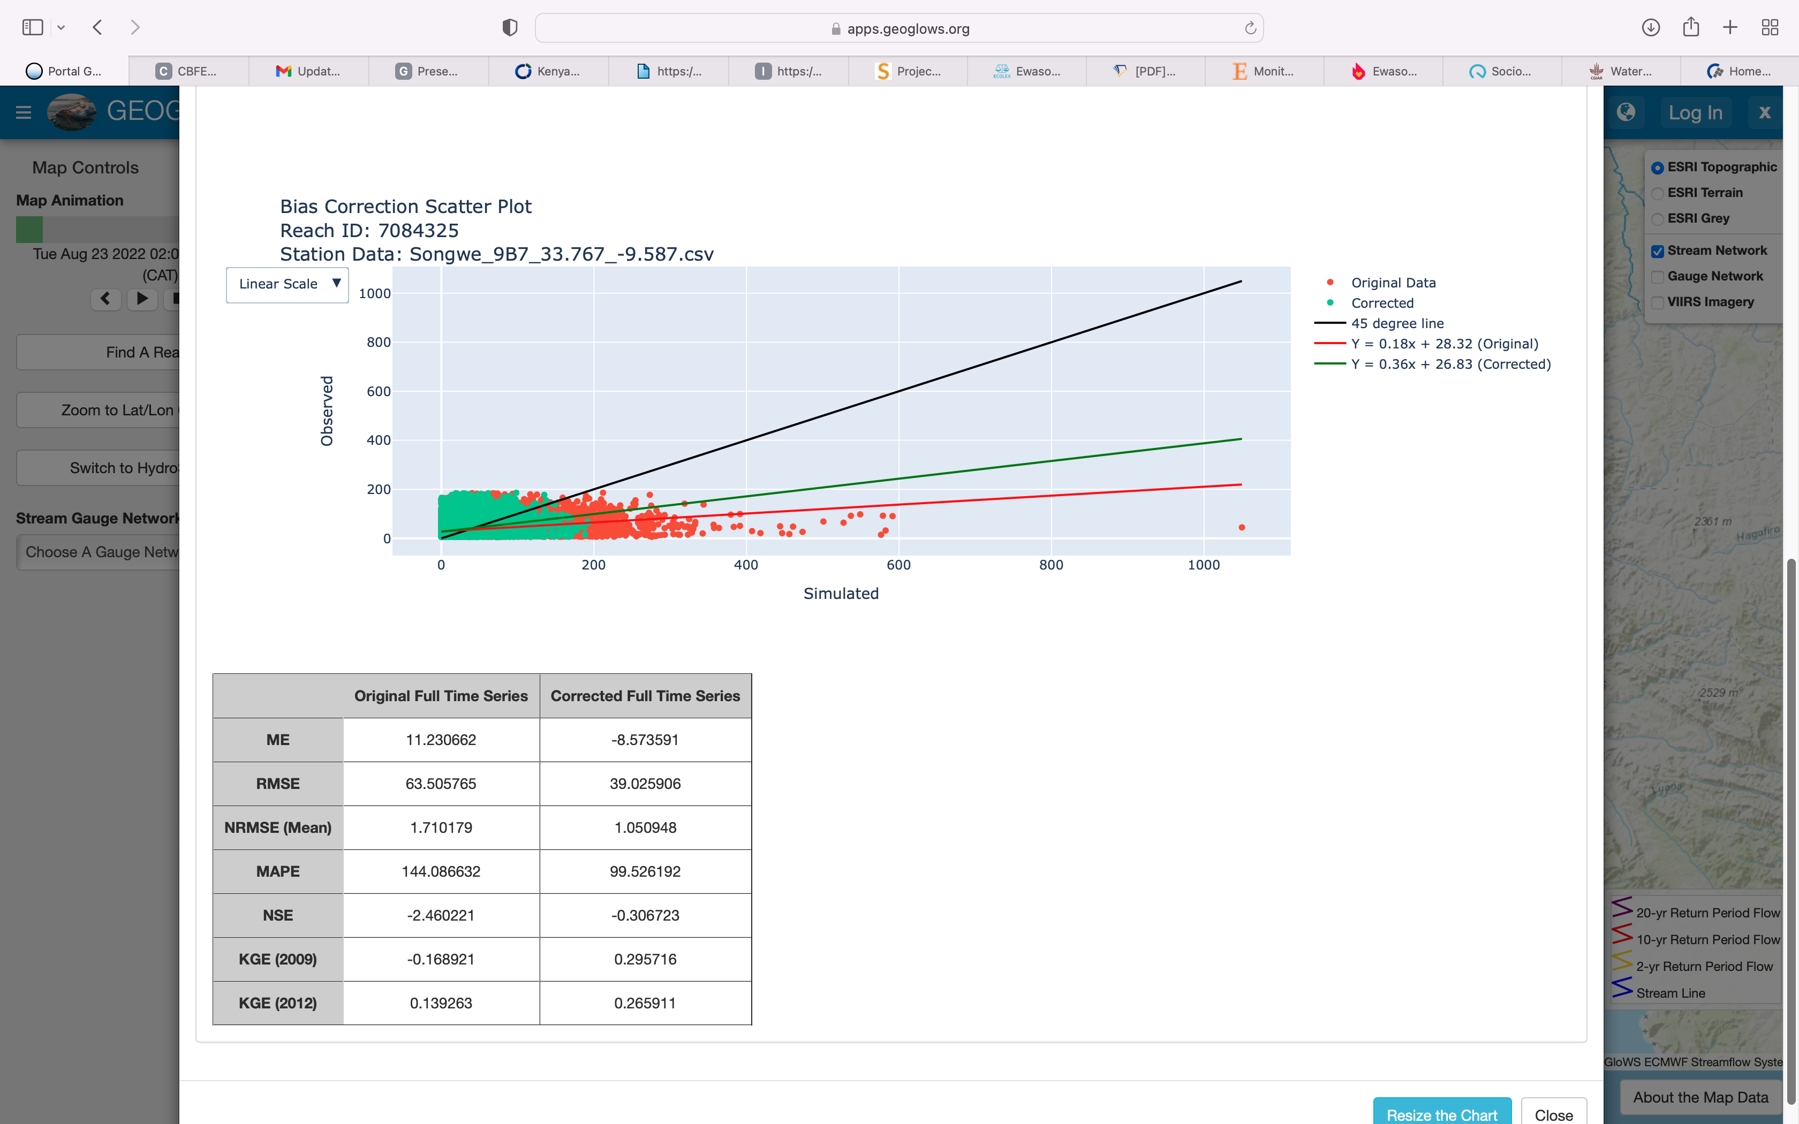
GEOGloWS Bias Correction on Historical Observed

Slide 20
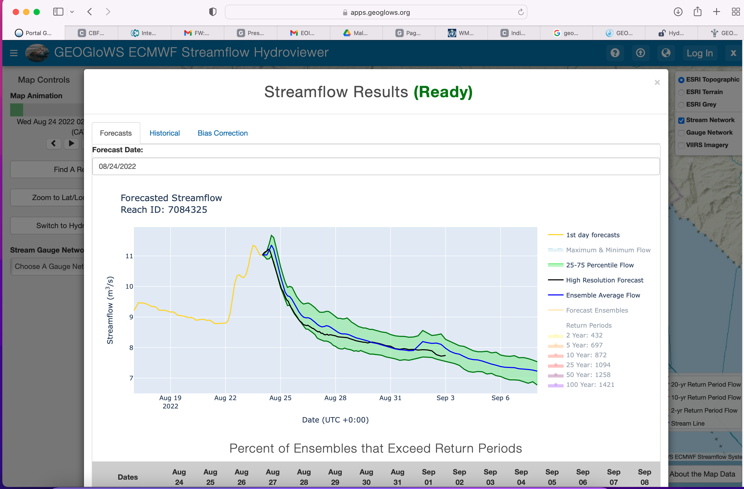
GEOGloWS Streamflow Forecast

Slide 21
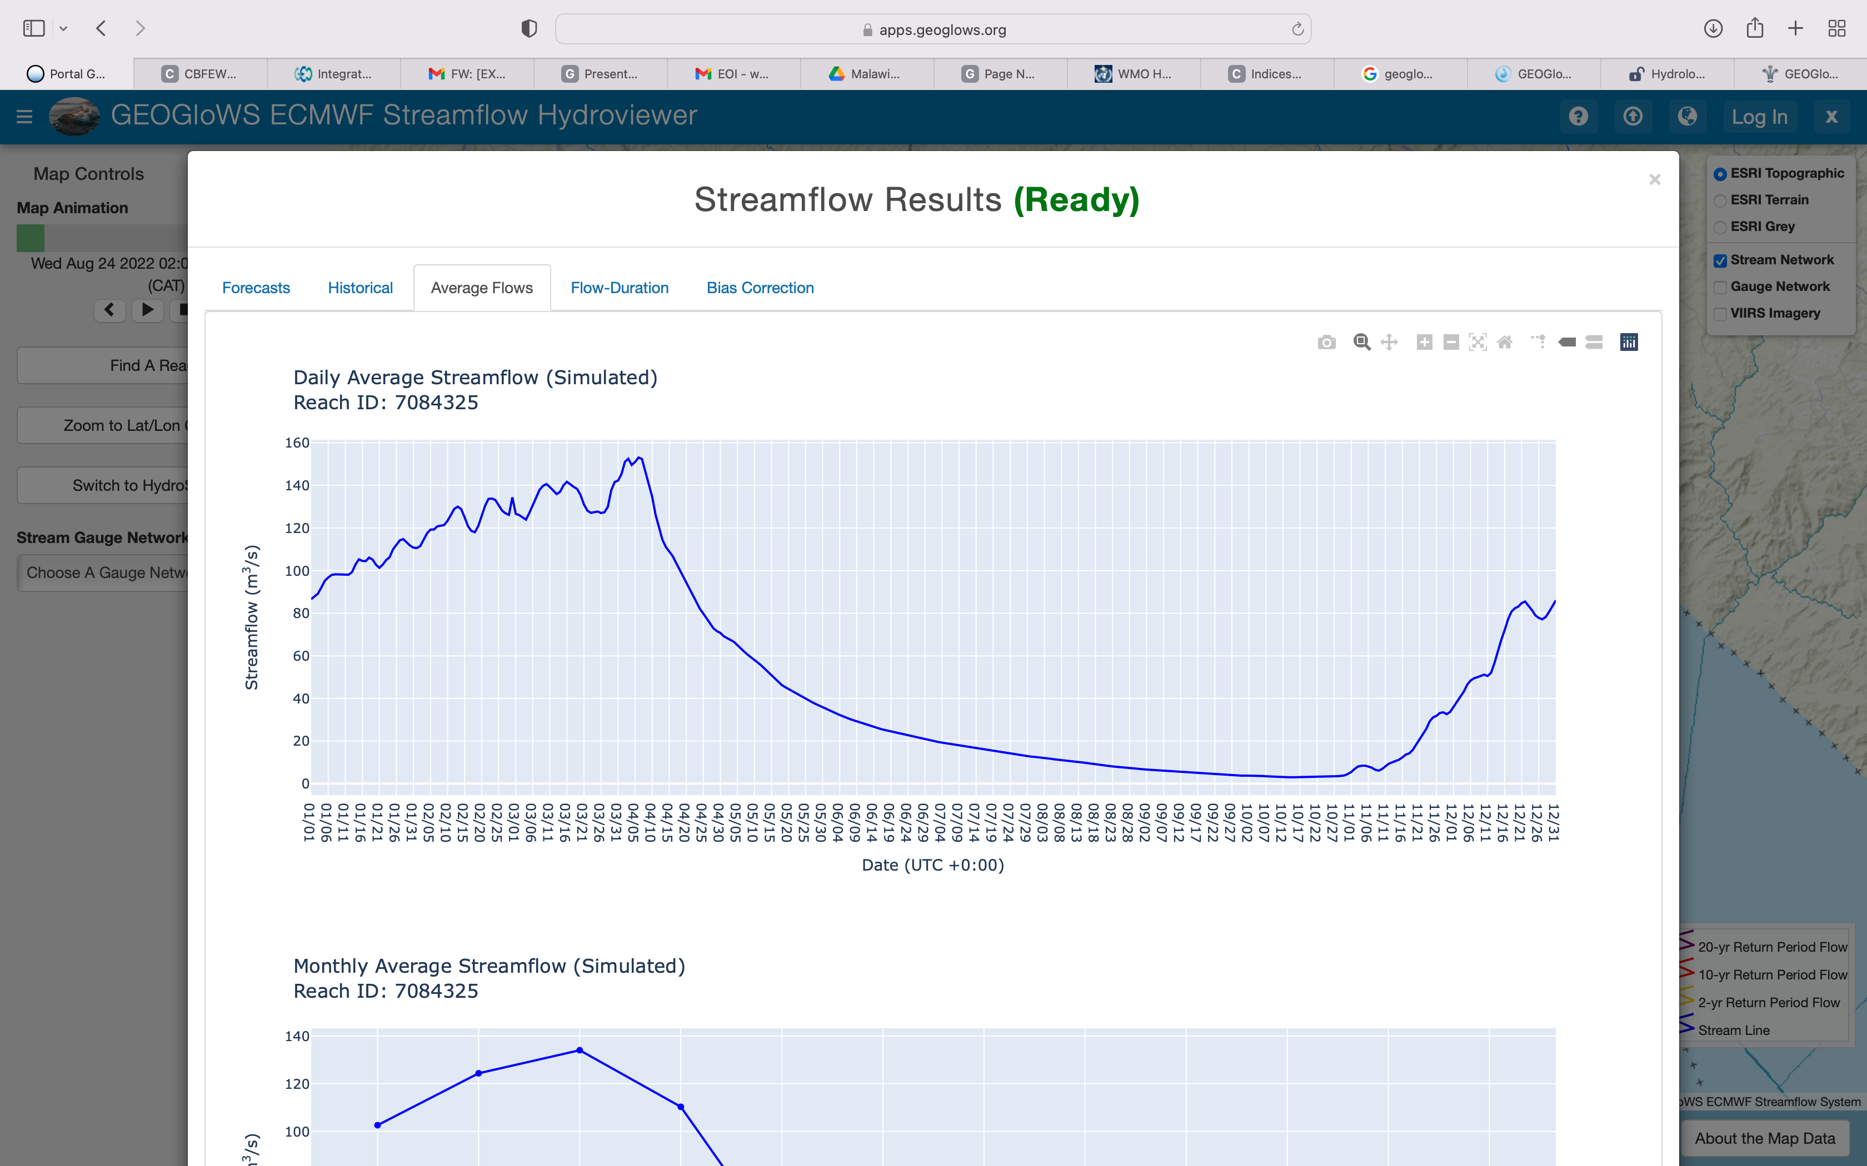
GEOGloWS Streamflow data Analysis

Slide 22
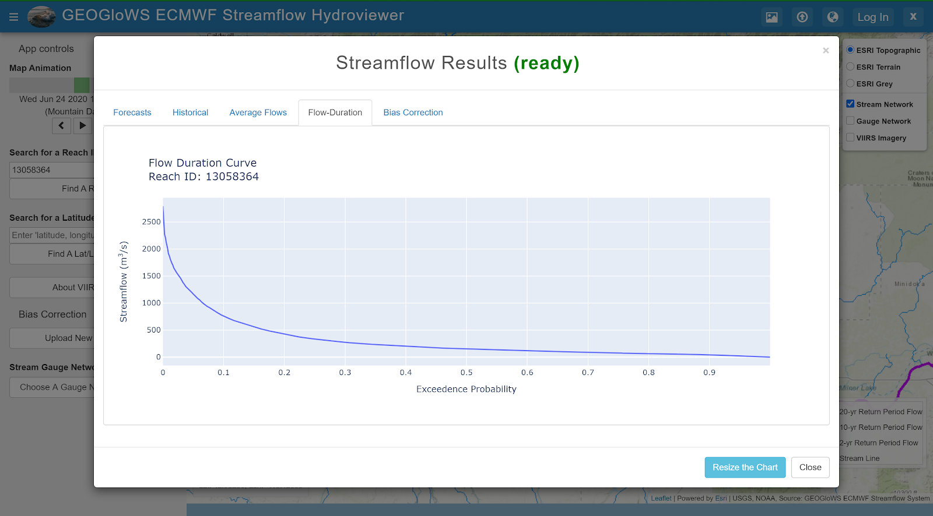
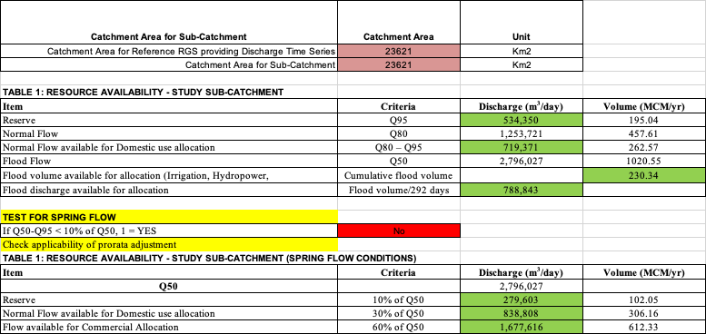
GEOGloWS Flow Duration Curve
With the over 40 years of bias corrected or localized simulate historical data, we generate FDC to computed/extract statistical river flow indices and regime for Water Resources Assessment and Allocation and Planning; i.e
Q95- Reserved Flow
Q80, Normal Flow
Q50 Flood Flow

Slide 23
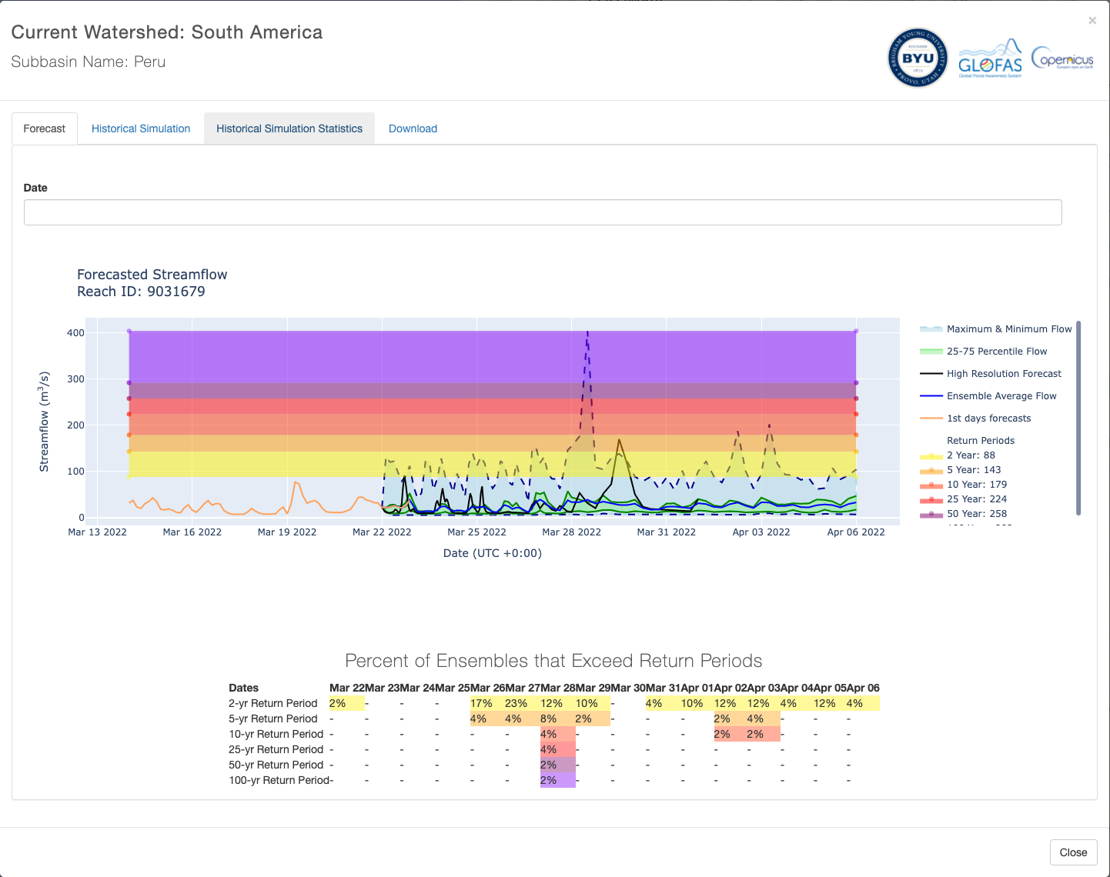
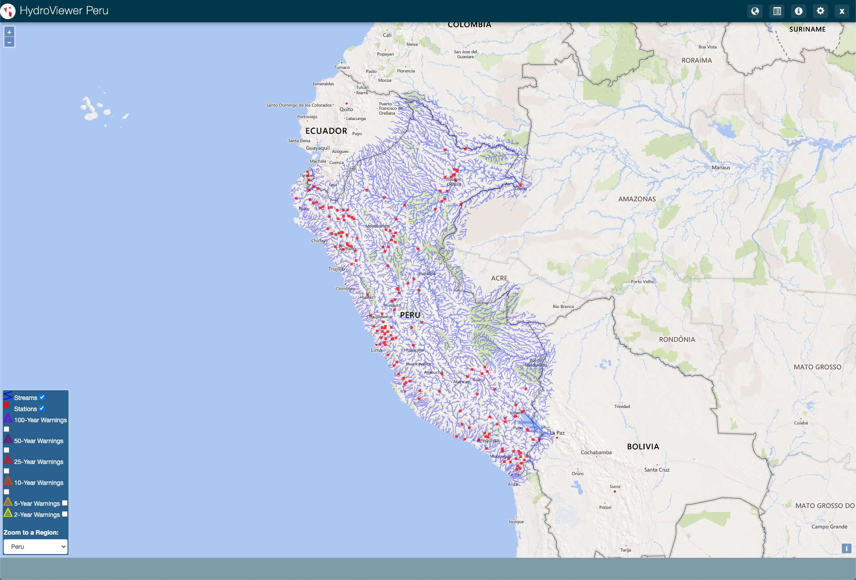
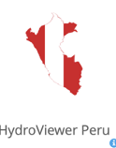
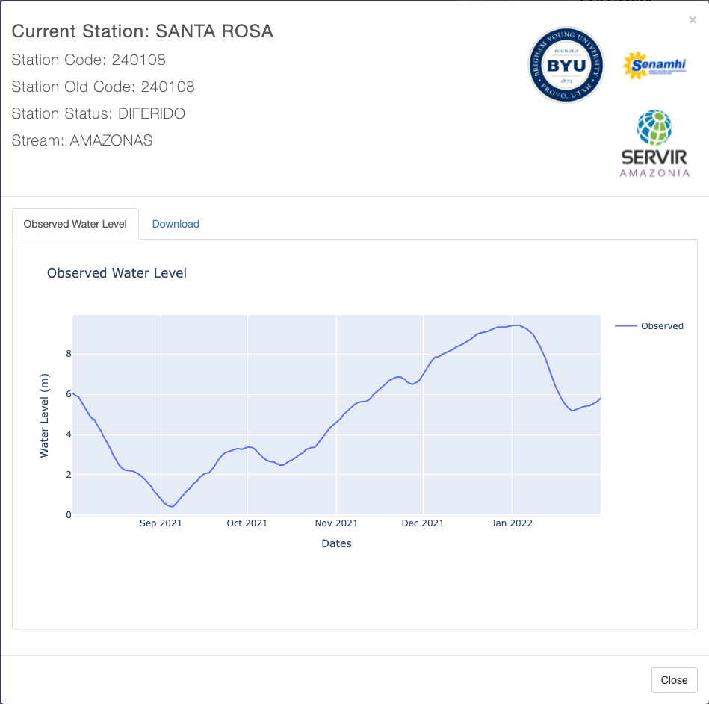
APPLICATIONS AND CASE USE
Customized Peru Hydroviewer – Monitoring & Forecasting

Slide 24
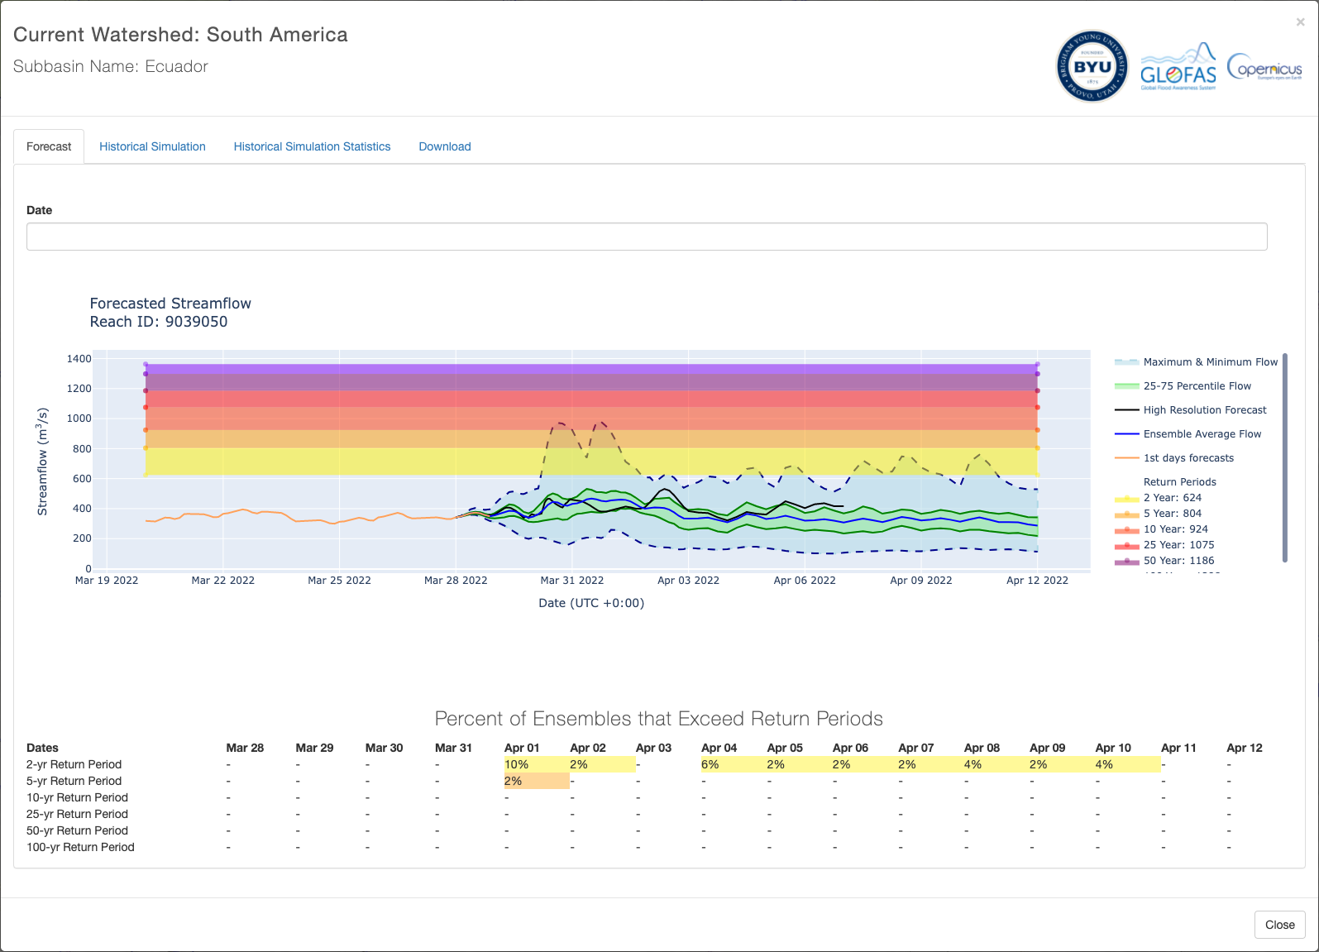
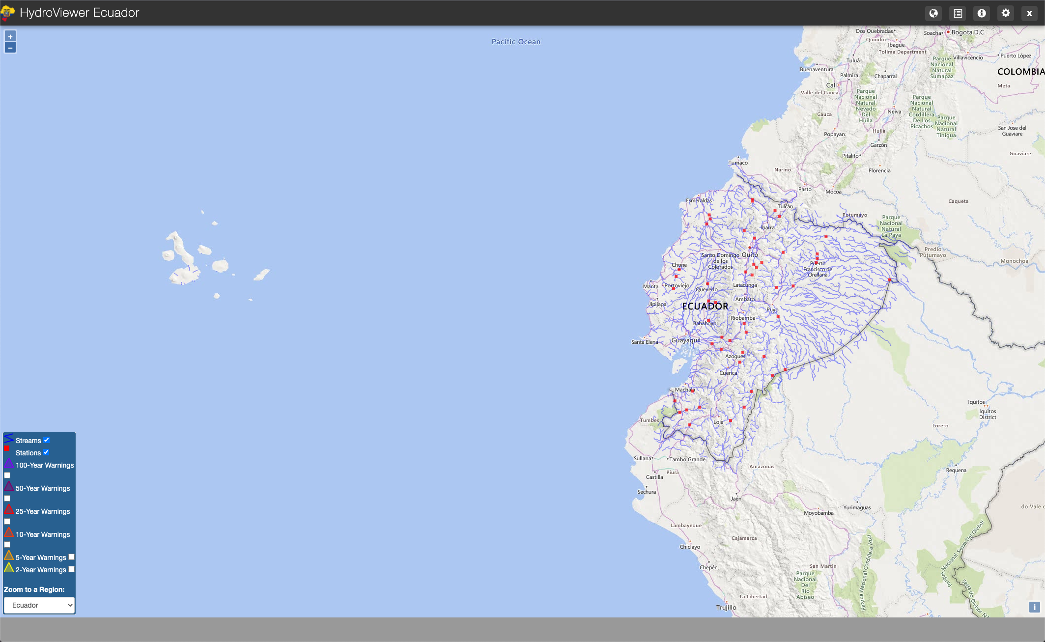
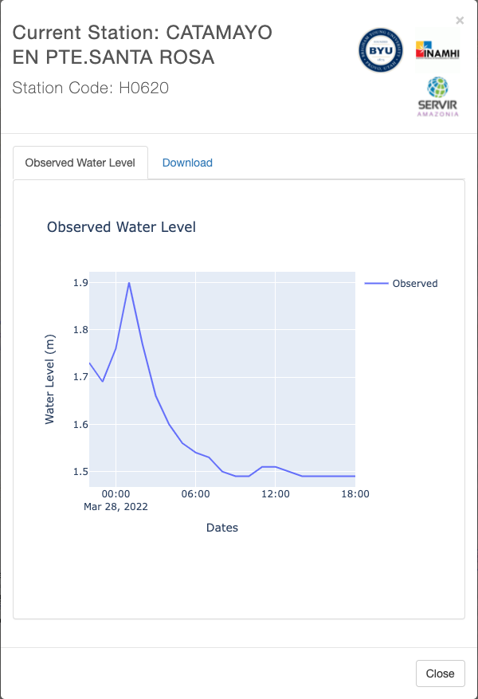
APPLICATIONS AND CASE USE
Customized Ecuador Hydroviewer
https://tethys-inamhi.westus2.cloudapp.azure.com/apps/hydroviewer-ecuador/

Slide 25
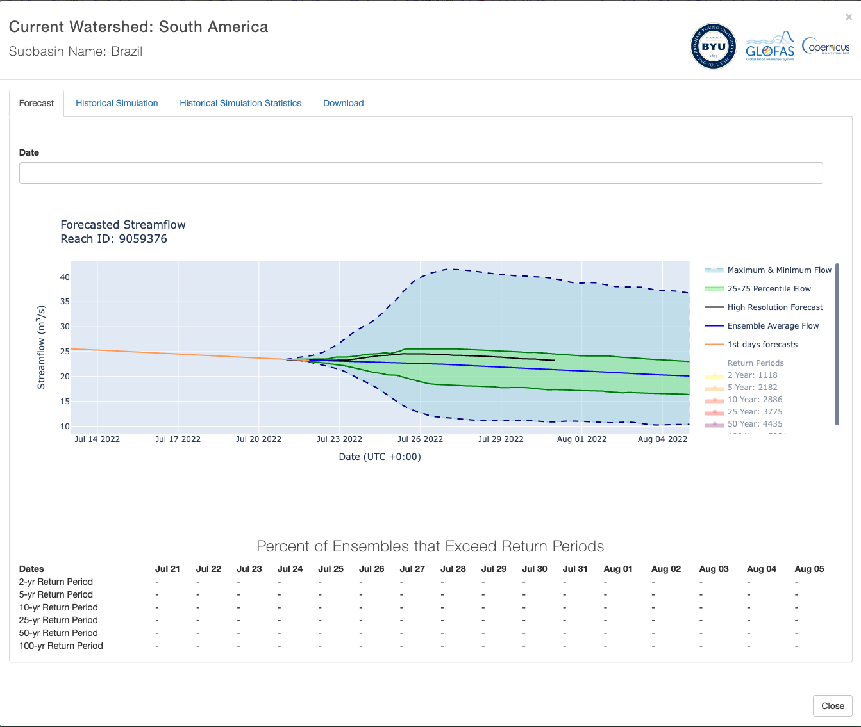
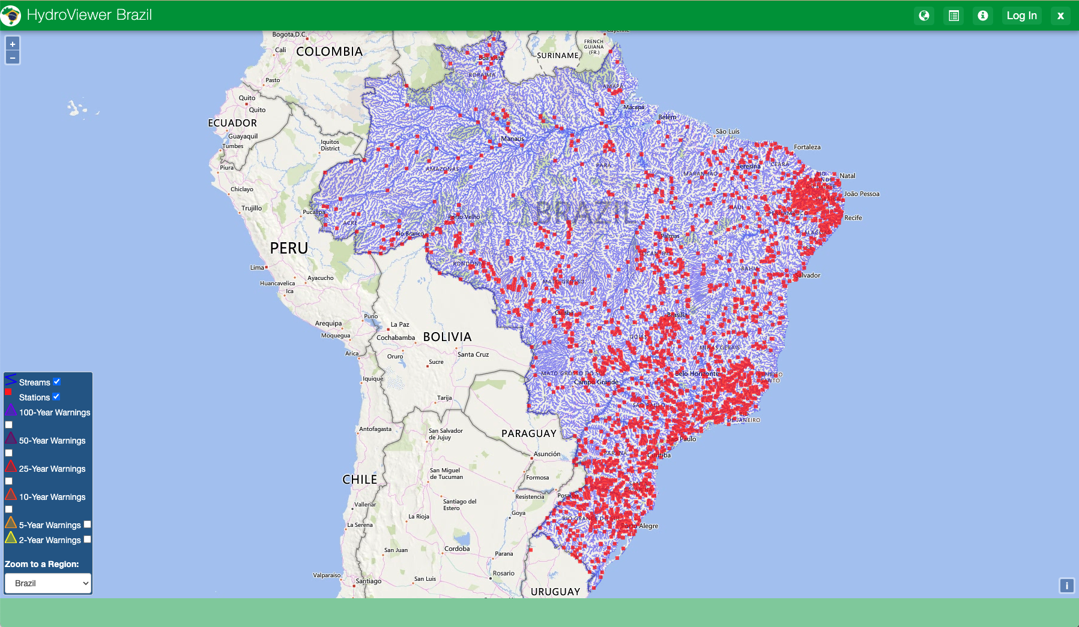
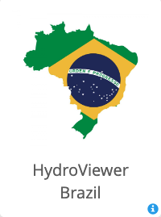
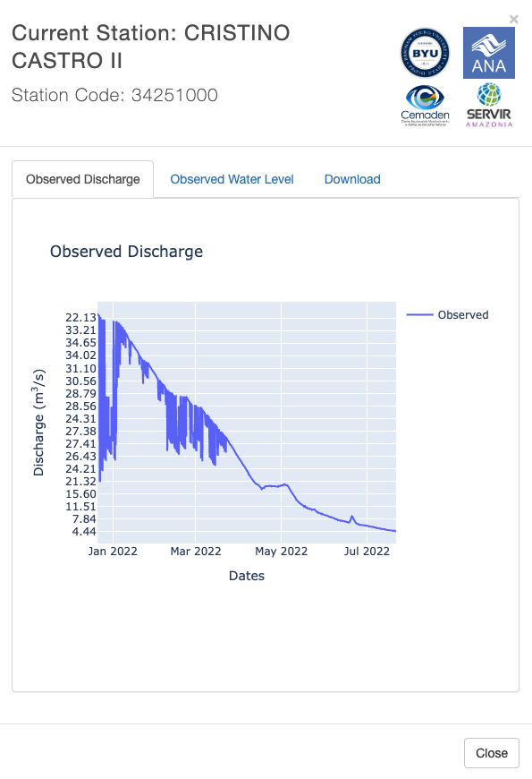
APPLICATIONS AND CASE USE
Customized Brazil Hydroviewer

Slide 26
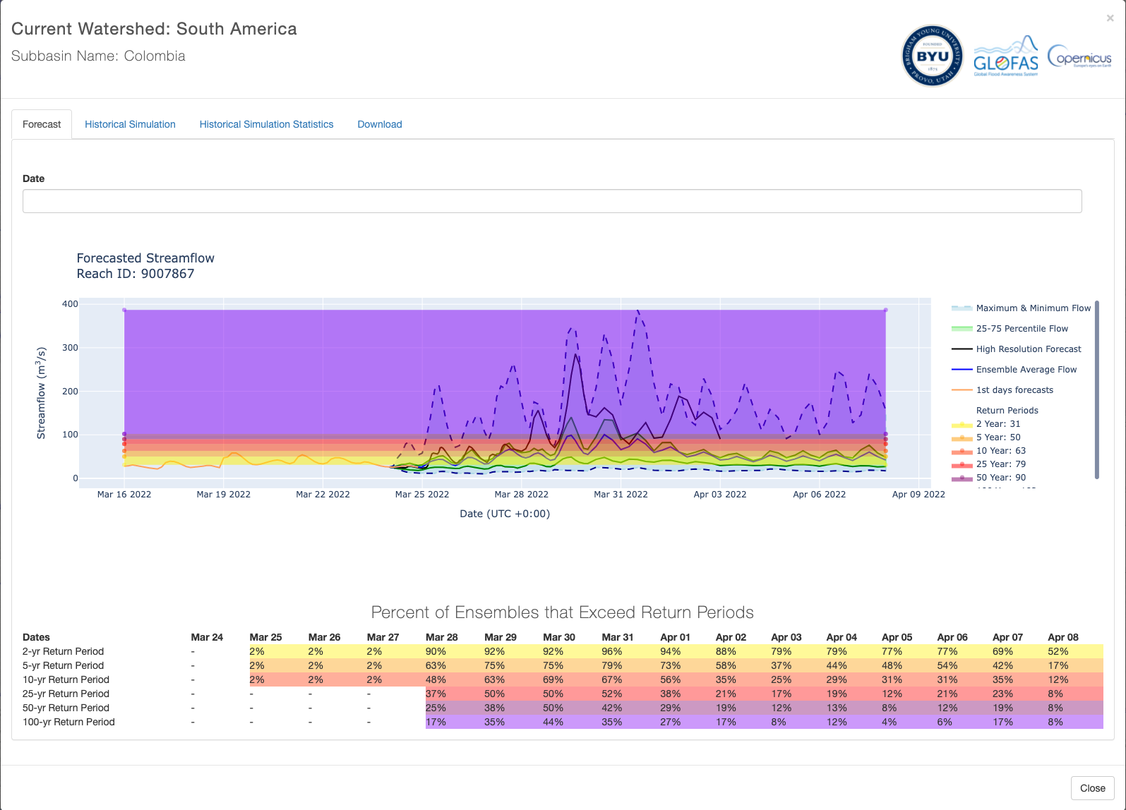
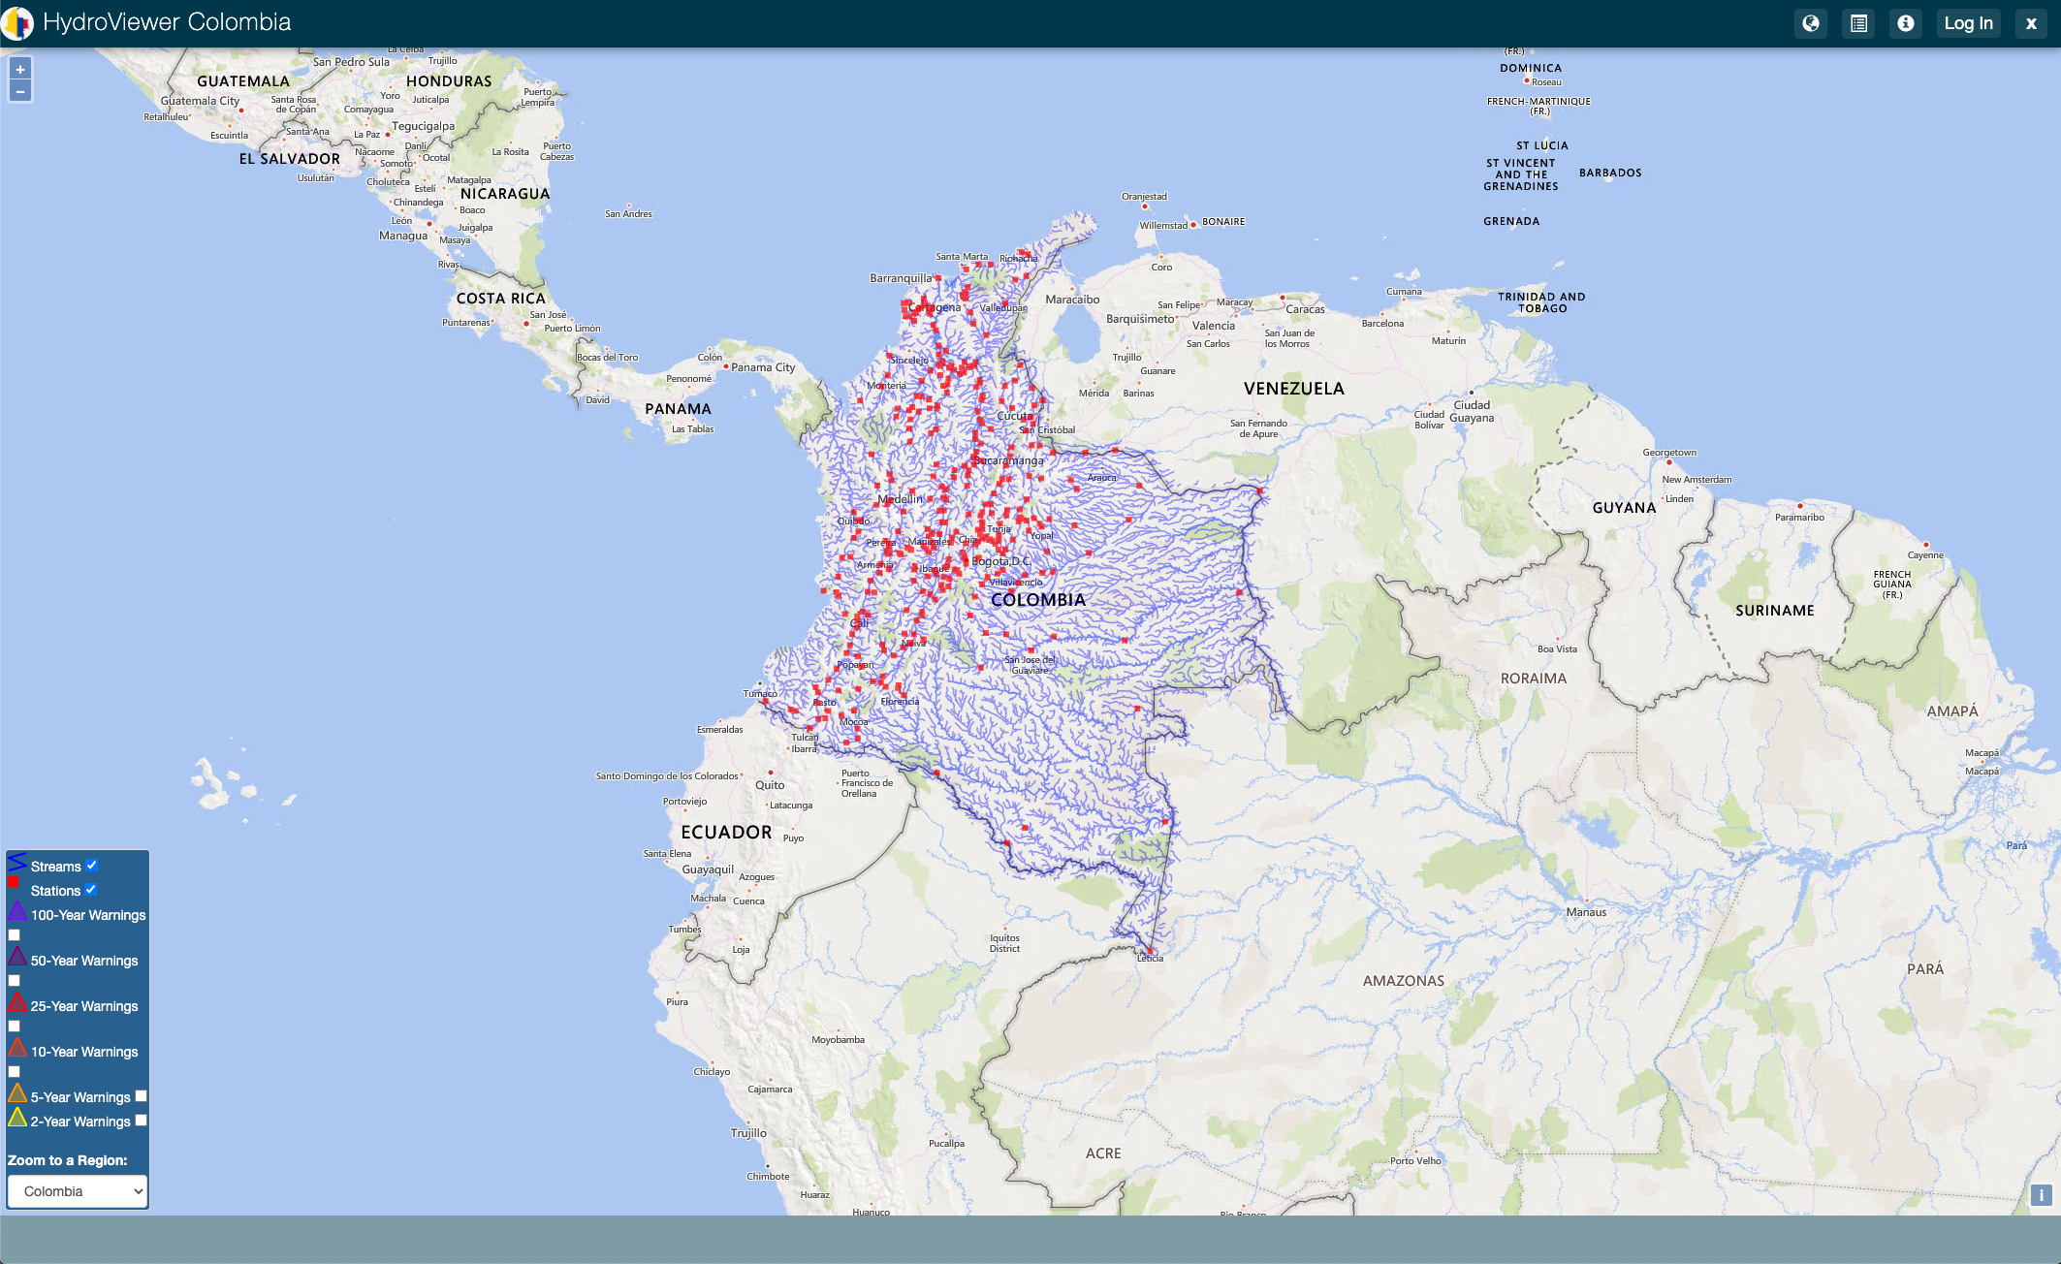
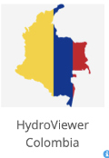
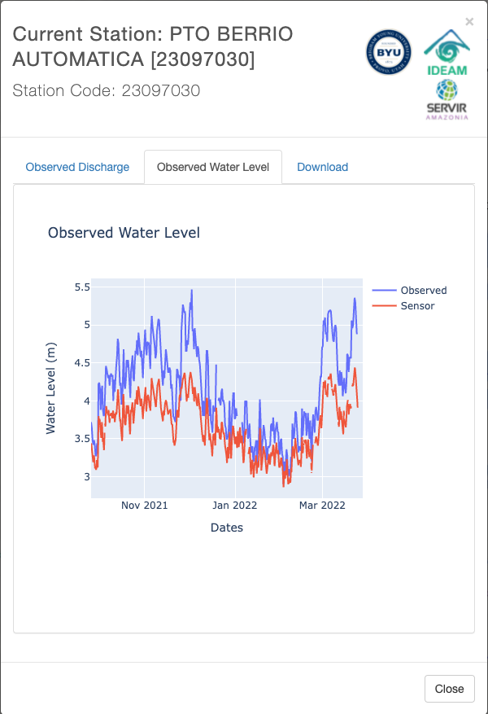
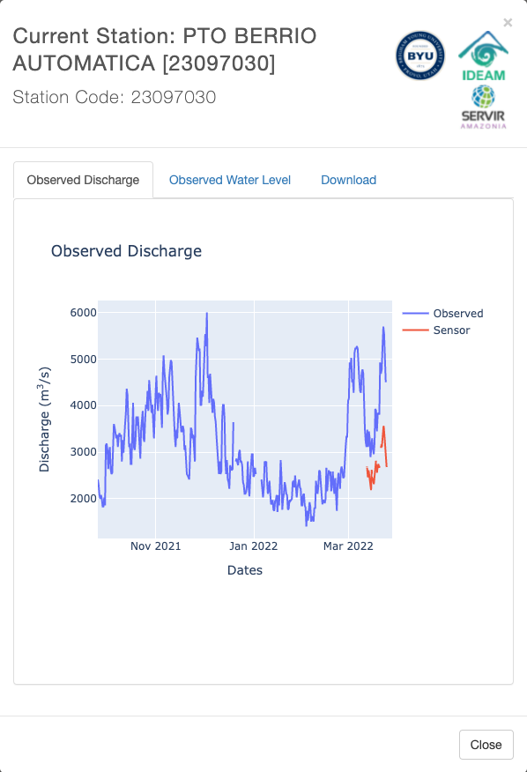
APPLICATIONS AND CASE USE
Customized Colombia Hydroviewer

Slide 27
APPLICATIONS AND CASE USE
Dominican Republic

Slide 28
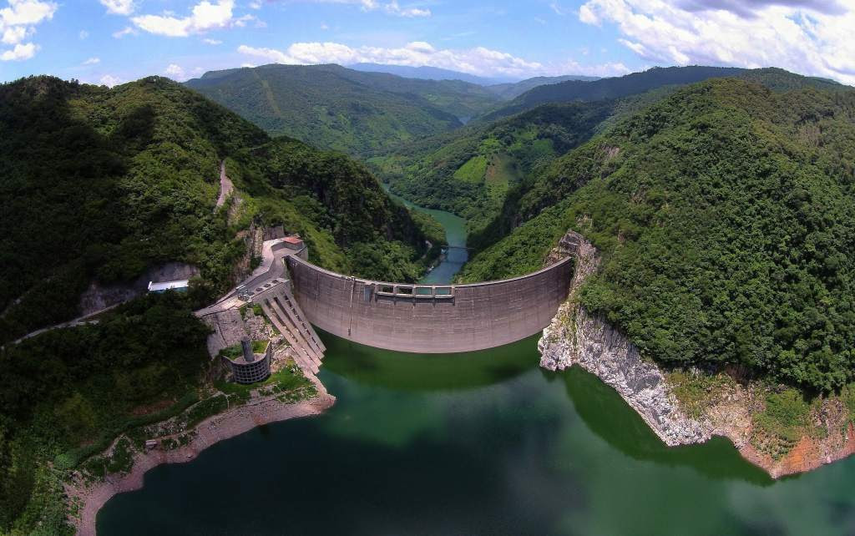
APPLICATIONS AND CASE USE
Honduras Hurricanes Eta/Iota

Slide 29
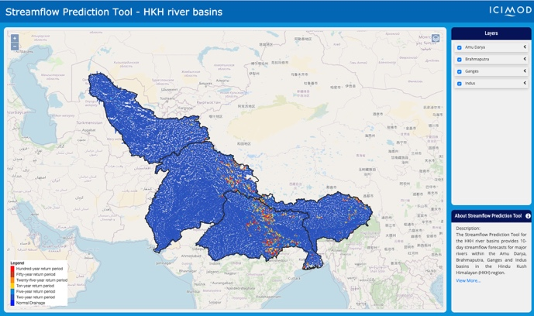
APPLICATIONS AND CASE USE
Hindu Kush Himalaya

Slide 30
MALAWI
In Malawi, hydroclimatic disasters (Flood & Drought) constitute more than 75% of all natural disasters.
With the economy heavily dependent on rural agriculture, the hardest hit are rural communities who are least prepared and most vulnerable to the impacts of such disasters.
Observed data indicates that floods are increasing in frequency & magnitude with increased destruction lives, livelihood and physical infrastructure hence reversing recent economic gains.
Factors increasing Malawi’s vulnerability;
Demographics trend in the country’s vulnerable floodplains
Impact of climate change and variability,
Over-reliance on in-situ measurements for water resources monitoring and flood forecasting.

Slide 31
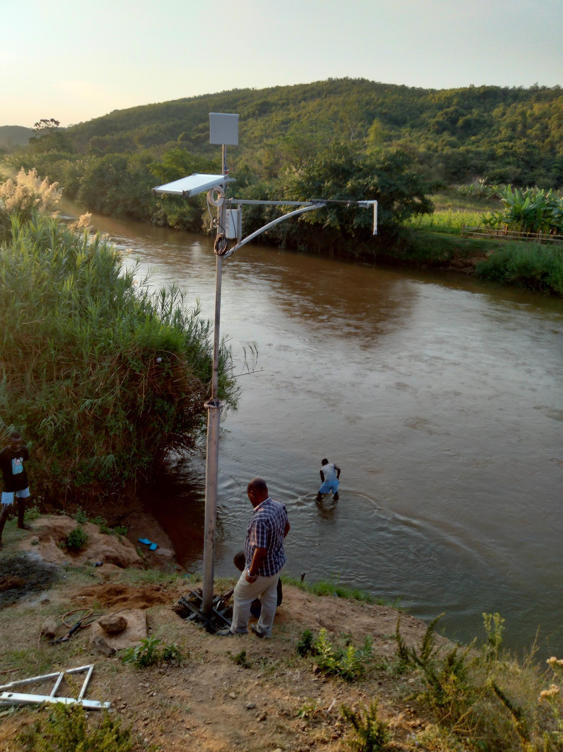
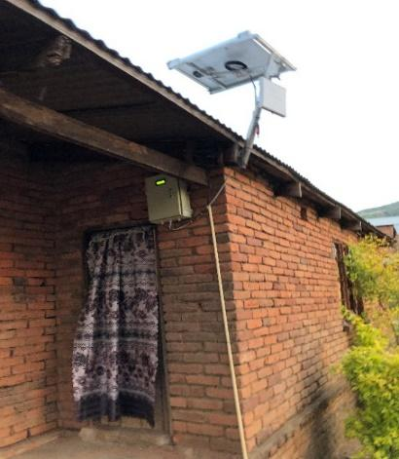
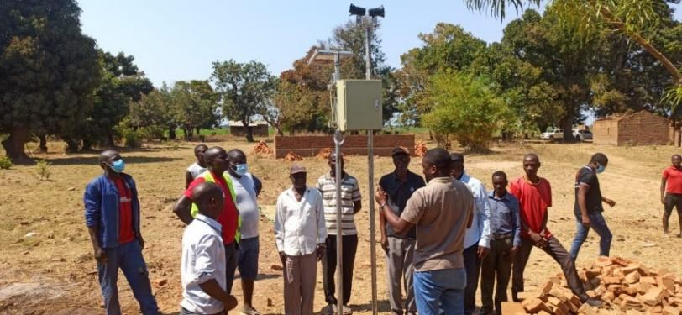
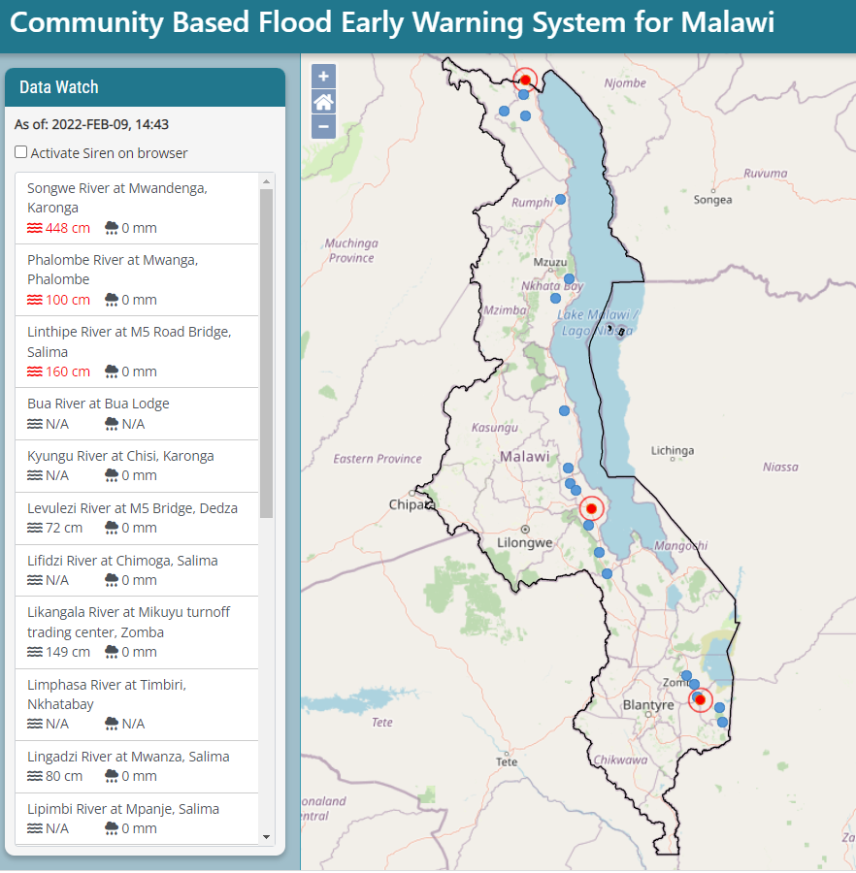
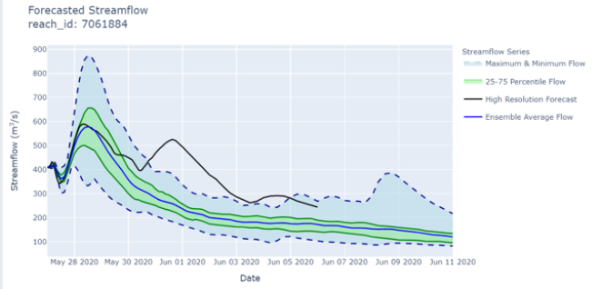
ESTABLISHMENT OF CBFEWS
(1.) Water level Sensor (DA)
(2.) Server Data Upload (DU)
(3.) Alarm Unit (AU)
Data Transmission
Alarm Triger
OC trigger
(6.) Operation CBFEWS platform
Alarm track
(5.) GEOGloWS Streamflow forecast data
(4.) Manual River Staff Gauge
REST API
Warning & Alert levels calibration & validation

Slide 32
Integrated CBFEWS System Supporting DRR in Malawi
GSM
Telemtry
REST
API

Slide 33
TELEMETRIC COMPONENT OF THE CBFEWS
Community Caretakers upstream (telemetric sensor location) and downstream (Flood plain where Alarm is installed).
Data Upload Unit and telemetric rain gauge (located within the Upstream Caretaker house),
Manual River gauge for flood warning verification,
Alarm/Loud Siren for Community Warning
Mass SMS for warning dissemination
Data visualization platform -DoDMA, DCCMS and DWR accessible by community and humanitarian organization.

Slide 34
Community-Based Flood Early Warning System

Slide 35
Community-Based Flood Early Warning System
Flood Warning Level
Flood Alert Level
Current Water Level

Slide 36
Community-Based Flood Early Warning System
Alarm and siren is activated when the telemetric water level reaches the Warning Level.

Slide 37
Community-Based Flood Early Warning System
Flood recession.

Slide 38
Community-Based Flood Early Warning System
GEOGloWS also compliments during the telemetric down time.

Slide 39
GEO – AWS Initiative

Slide 40
GEOGloWS –Initiative in Africa
LESOTHO

Slide 41
THANK YOU

